Slide 1
Breaking through the backlog! Exploring tech-driven solutions for digital collections stewardship
PULINET 2025
Javanica Curry
Sr. Director Institutional Development and Strategic Partnerships
Notes:
Introduction and agenda
Time: 3 minutes
Slide time: 1 minute
Good morning everyone and welcome. My name is Javanica Curry and I am the Sr. Director for Institutional Development and Strategic Partnerships at ITHAKA and JSTOR.
I’m delighted to be here with you today to share some of the exciting mission-aligned initiatives we’ve been working on to better serve your library during this time of rapid technological transformation. Many of you in this room may be familiar with JSTOR as a journals database. I hope that by the end of this presentation I will have successfully demonstrated that JSTOR is so much more than backfile journals and that ITHAKA is continuing to find ways to support your libraries in relevant and innovative ways. And I hope you will be as excited for the future as we are. So let’s get started.

Slide 2
ITHAKA is a nonprofit with a mission to improve access to knowledge and education for people around the world. We believe education is key to the well-being of individuals and society, and we work to make it more effective and affordable.
Notes:
30 seconds
First, some folks have wondered if JSTOR is changing our name--we are not! ITHAKA is the parent organization of JSTOR and has been in existence for quite some time. ITHAKA is a not for profit organization with a mission to improve access to knowledge and education for people around the world. We believe education is key to the well-being of individuals and society, and we work to make it more effective and affordable. We fulfill out mission through content development, technology innovations, and research on issues that impact the library and academic communities.

Slide 3
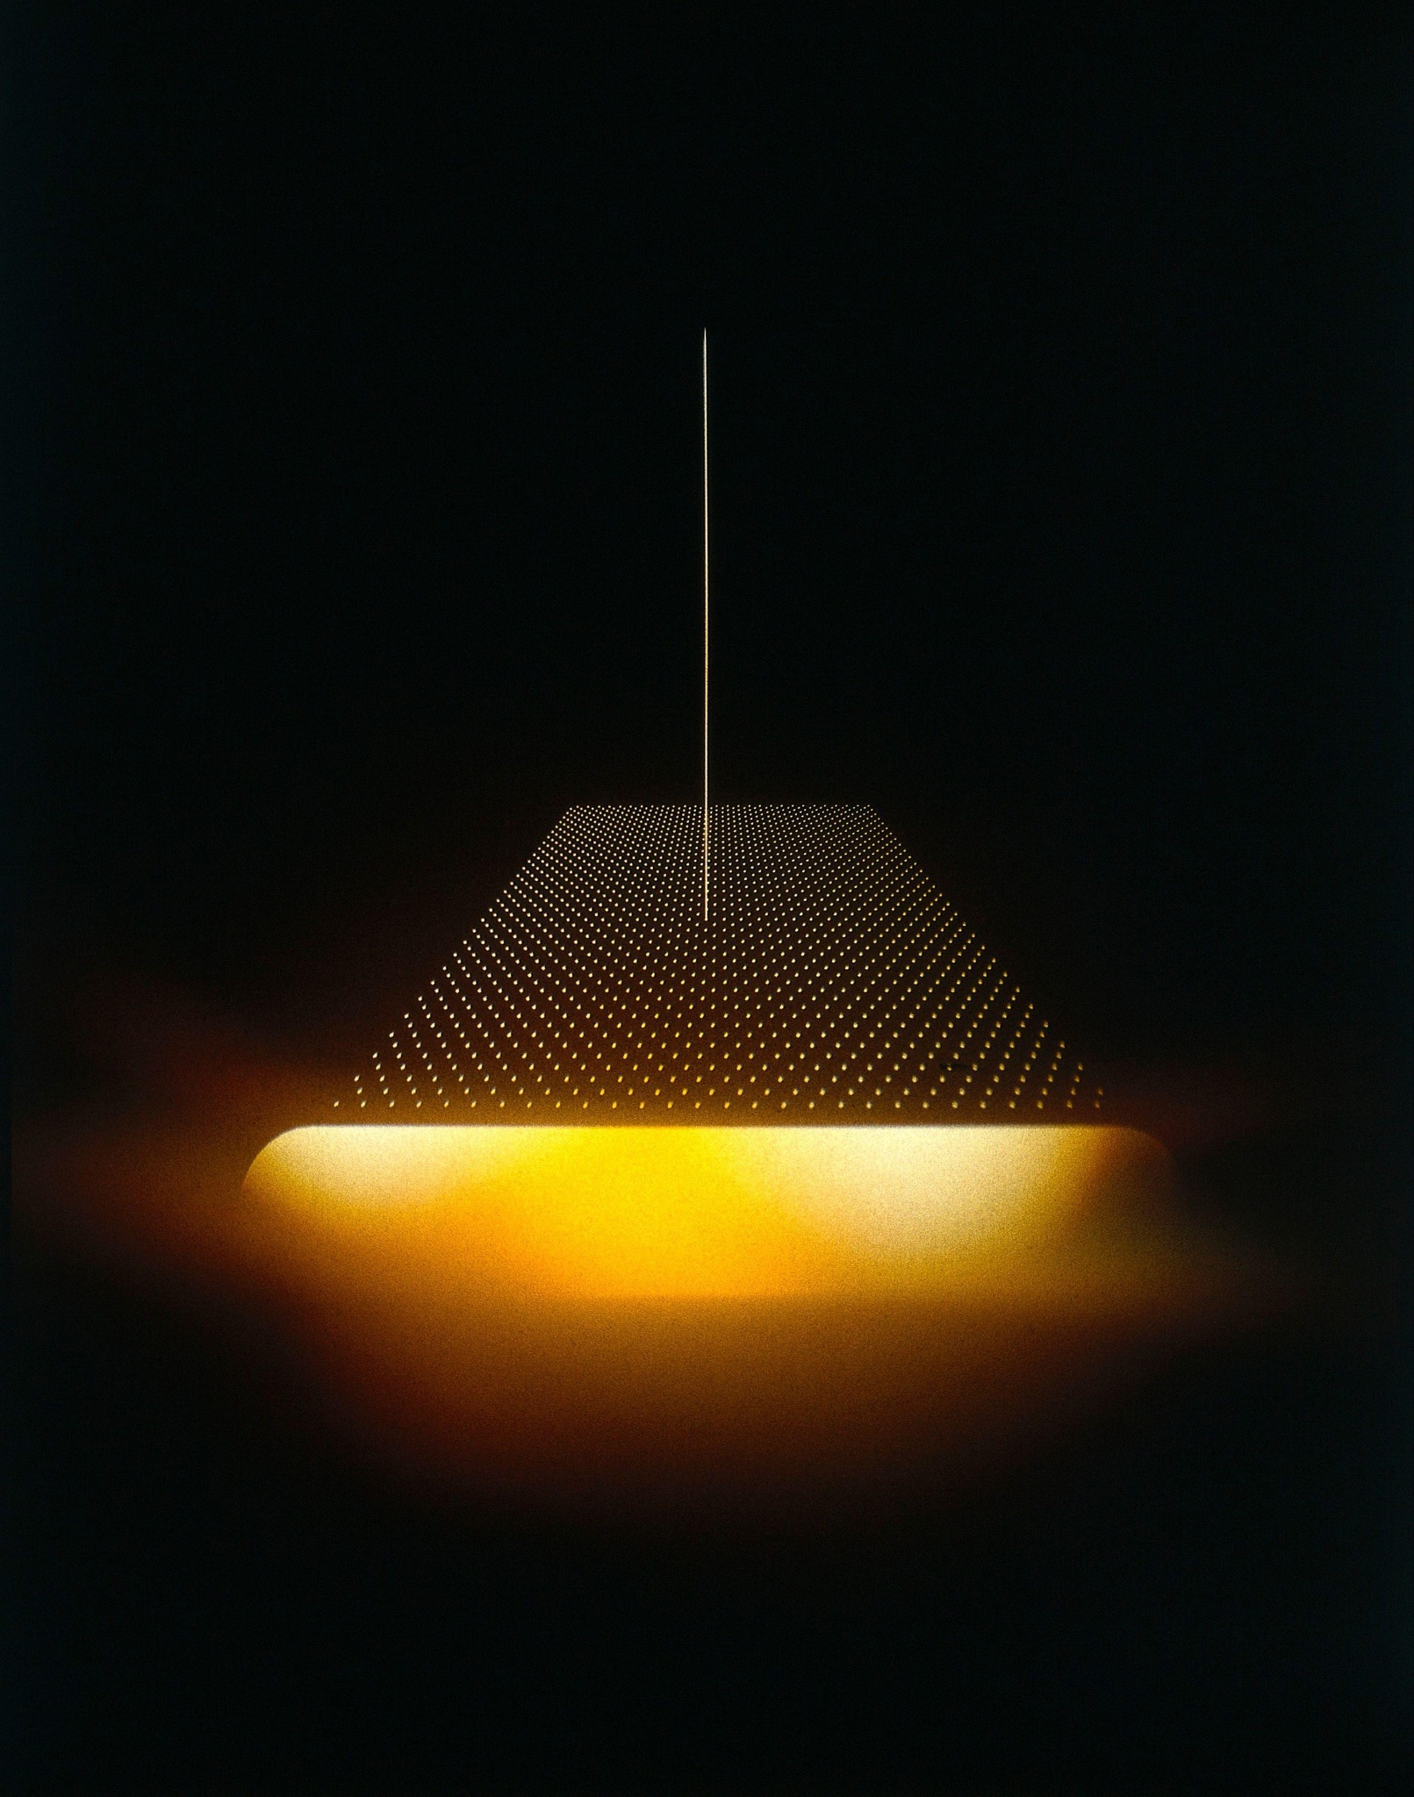
Agenda
Explore collaborative, tech-driven solutions for digital collections stewardship with:
Digital collections landscape
JSTOR services for supporting digital stewardship
JSTOR Collections processing prototype
Paul Griggs. Microarray analysis. n.d. Part of Open: Wellcome Collection
Notes:
Speaker: Rebecca
Today I will be demoing a prototype of new software that uses JSTOR Enginnering and AI to rapidly and dramatically increase the processing of digitized materials. However I will start by setting the context, giving a brief overview of where we sit within the workflows for managing digital collections. I will also highlight our existing tools that help you catalog, enable access, and preserve your digitized special collections.

Slide 4

The digital collections stewardship landscape
Notes:
Speaker: Rebecca
Section Time: 3-minutes
So let’s take a look at this landscape more broadly.

Slide 5
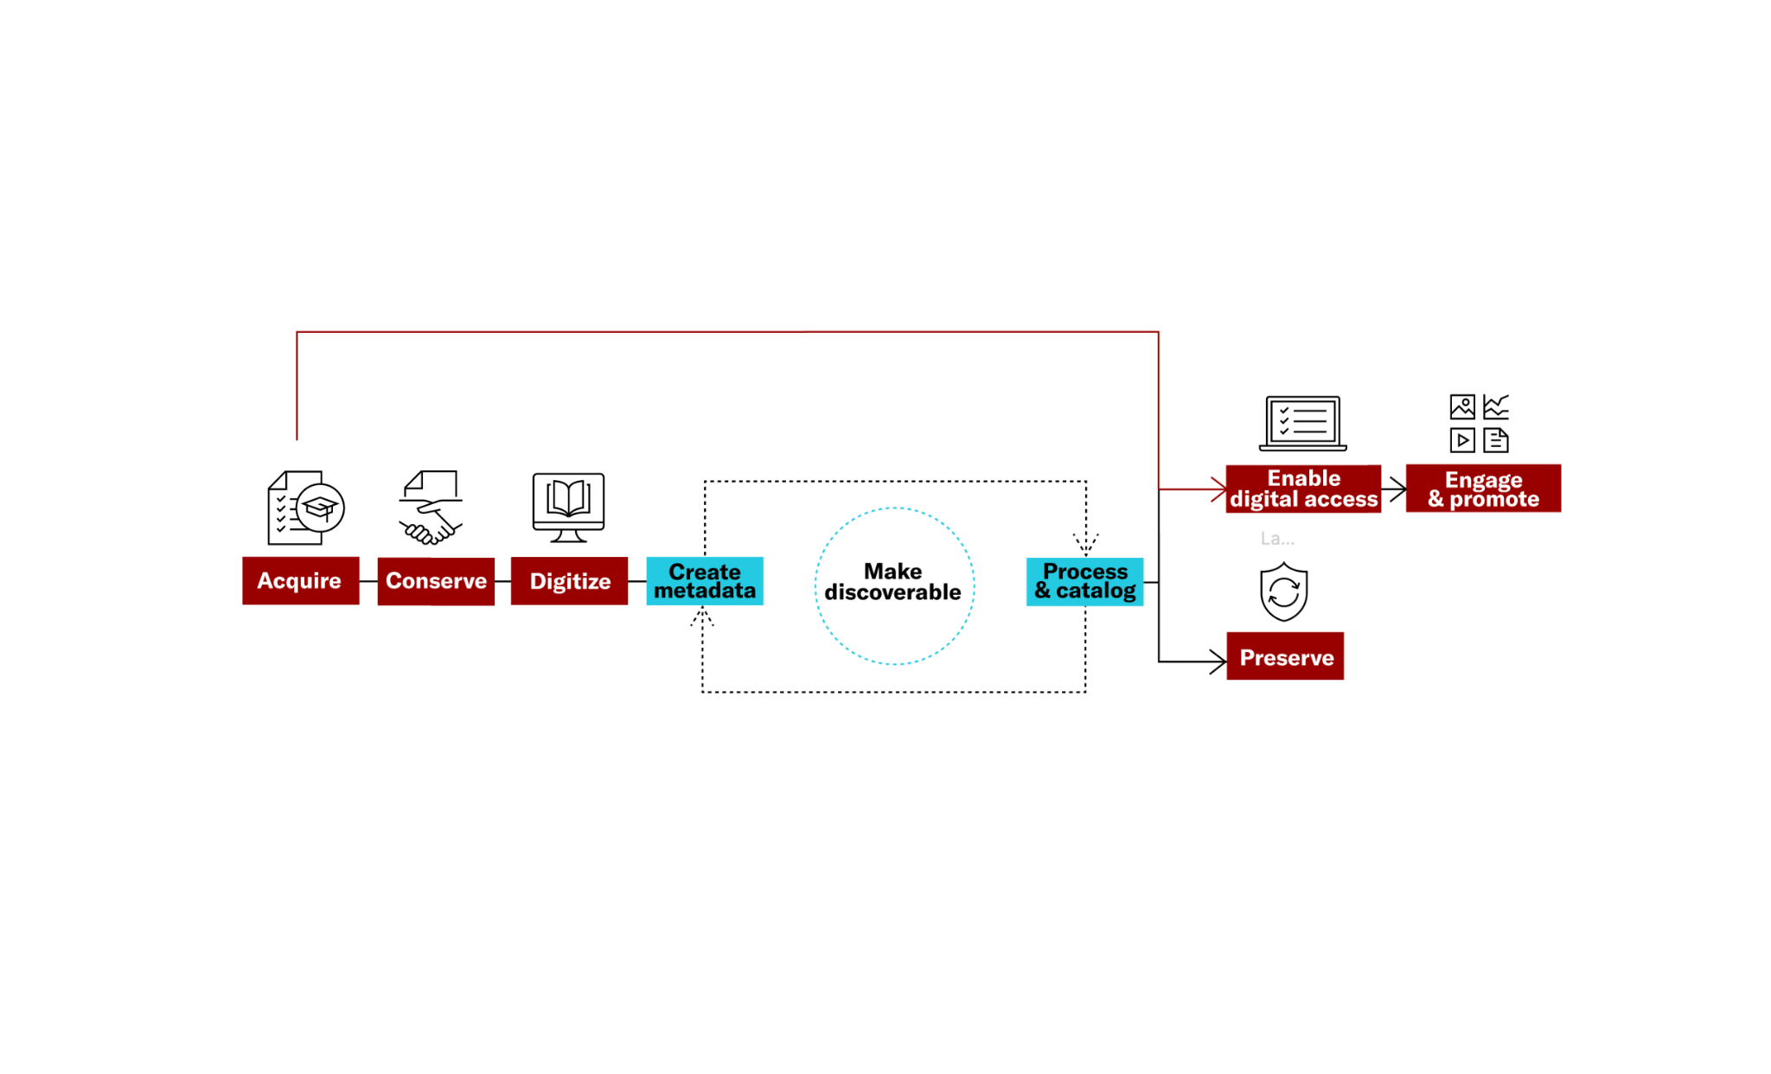
Digital collections workflow
Notes:
Speaker: Rebecca
As stewards of rare and unique digital collections, libraries face many challenges. We have been evolving our knowledge in this space since we first launched a pilot called open community collections 5 years ago. As we have deepened our research and relationships and expanded the solutions we offer, we’ve gotten a very clear picture of an environment where libraries are struggling with the overwhelming backlog of digitization, metadata creation, and preservation tasks.

Slide 6
























Digital collections ecosystem
These are the various combinations of tools seen in a sample of 20 schools interviewed. There was no consistent combination of tools or pre-set workflows between the vast majority of them.
Notes:
Speaker: Rebecca
In the Digital Collections Ecosystem, these are the various combinations of tools seen in a sample of 20 universities we interviewed. There was no consistent combination of tools or pre-set workflows between the vast majority of them. For institutions that have a robust tapestry of interconnected systems, they may be looking to augment, enhance, or replace only individual components. Others really need a comprehensive solution that crosses these silos and helps them get started with or simplify workflows. It’s no wonder we’ve encountered so many talented special collections managers and archivists who feel so proud and protective of the work they do, while also admitting to being overwhelmed.

Slide 7

The challenges
What we’ve heard:
Limited resources
Born-digital growth exceeds capacity
Unprocessed backlog of digital collections
Fragmented solution landscape
Notes:
Speaker: Rebecca
We conducted over 100 interviews with library leaders over the last two years and consistently heard that due to the volume and pace of acquiring digital content, most digital collections are unprocessed. We’ve heard esitmates as high as 95%. In some cases, due to resource contraints, teams have backlogs that can take a decade to work through.
Compounding this are issues related to obsolescence of file formats and software and understanding how to preserve the various formats of digitized and born digital content.
It’s difficult to get the resources needed to address these complexities and technological barriers, because while the concept of digital stewardship is paramount within the library, it doesn’t always align with the strategic priorities of the institutions as a whole.
We also learned that no one is totally happy with their current approach: we talked to many institutions who have a lone staff member using open source systems, which are great from a cost perspective but lack support and stability, or institutions that have 6 or more different vendor systems, like in my previous slide, impactig multiple teams across various processes.

Slide 8
JSTOR’s solutions for digital collections stewardship
Notes:
Speaker: Jason
Section Time: 5-minutes
As a nonprofit organization with almost 30 years experience using technology to offer access to and preserve digital content, we felt compelled to evolve beyond our core digital library and Portico products to create new services that help overcome these barriers.

Slide 9




A suite of services for digital collection stewardship
Speed up and streamline workflow. Amplify the reach of your special collections — including audio and video. And help further our mission to expand global access to knowledge.
NEW
Understand & describe materials
with the collection processing
prototype (beta)
Build & manage collections
with Forum
Preserve materials
with Portico
Share collections
with JSTOR
Add ons:
Additional storage
Collection harvesting to
syndicate media and metadata
Audio and video to increase accessibility with editable transcripts
Notes:
Speaker: Jason
In 2023 ITHAKA launched a suite of services to support institutions in the stewardship of their digital collections, from building and cataloging their collections with JSTOR Forum, to increasing discovery and access of your collections by sharing them on the JSTOR platform, to providing long term managed preservation of your collections in through our preservation service called Portico.
We’ve intentionally designed these services to work together as a comprehensive suite where needed, or stand alone to enhance existing workflows.

Slide 10
Infrastructure Services
300+
3.3M
2,400+
Total participants (Forum, Shared Collections, Preserved Collections)
Collections shared on the JSTOR platform
Item requests
13% year over year increase
Stats are as of 27 Oct 2024
Notes:
Slide Presenter: Jason
After just over a year of these services being available, we are currently working with ~300 institutions and they are making over 2,000 collections available on the JSTOR platform. We have also seen the use of these speical collections steadily increasing each year.

Slide 11
JSTOR’s Collections Processing Prototype
Understand and describe your digitized special collections
Notes:
Speaker: Jason
Section Time: 15-minutes
In 2024 we embarked on an exploration called Project Odyssey, through which we explored how we could apply AI technology specifically to the digital collections workflow. Through this project we have developed a potentially transformative digital collections processing solution that leverages GenAI and the expertise of JSTOR engineering to significantly unlock digital collection backlogs, accelerate the efficiency of processing workflows and amplify the expertise of archivists and special collections librarians.

Slide 12
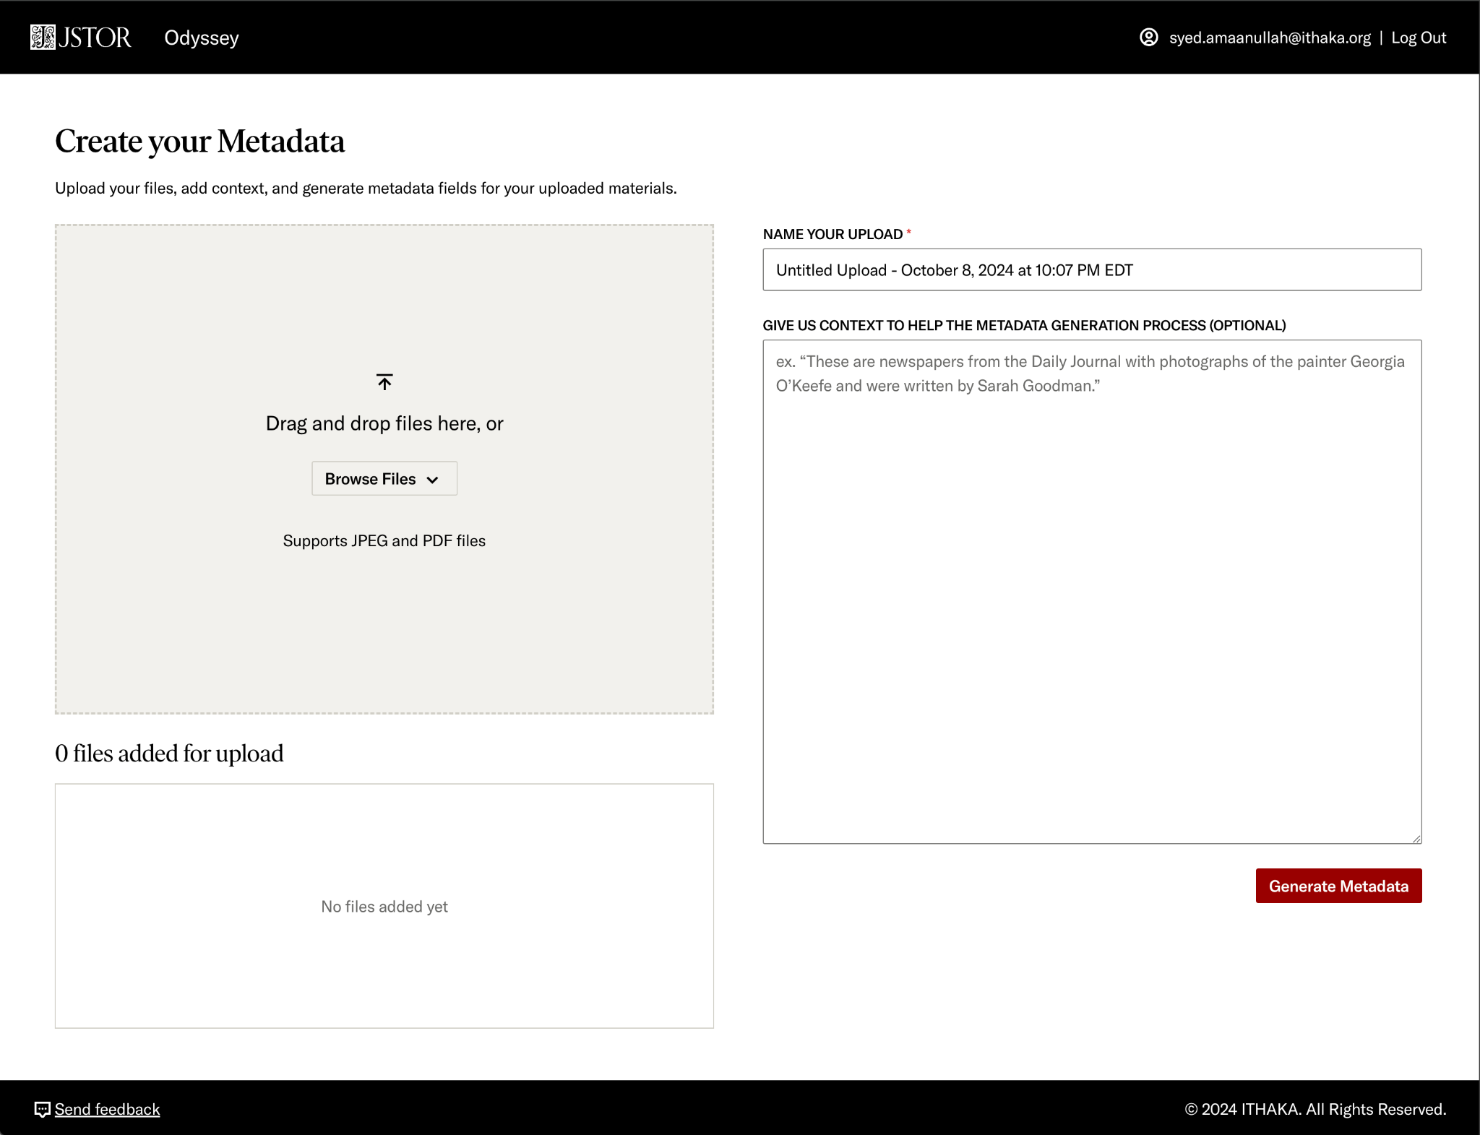
Notes:
Slide Presenter: Jason
We have built a product prototype that generates high-quality descriptive metadata, along with information and insights to help better understand and organize the materials, by simply uploading text and image materials into our system.
We have created an intuitive user-experience where archivists and librarians will be able to identify the materials for processing, and provide any preliminary context that could help the system generate a richer output. However this is not a necessary step for the system provide high quoality metadata records.

Slide 13
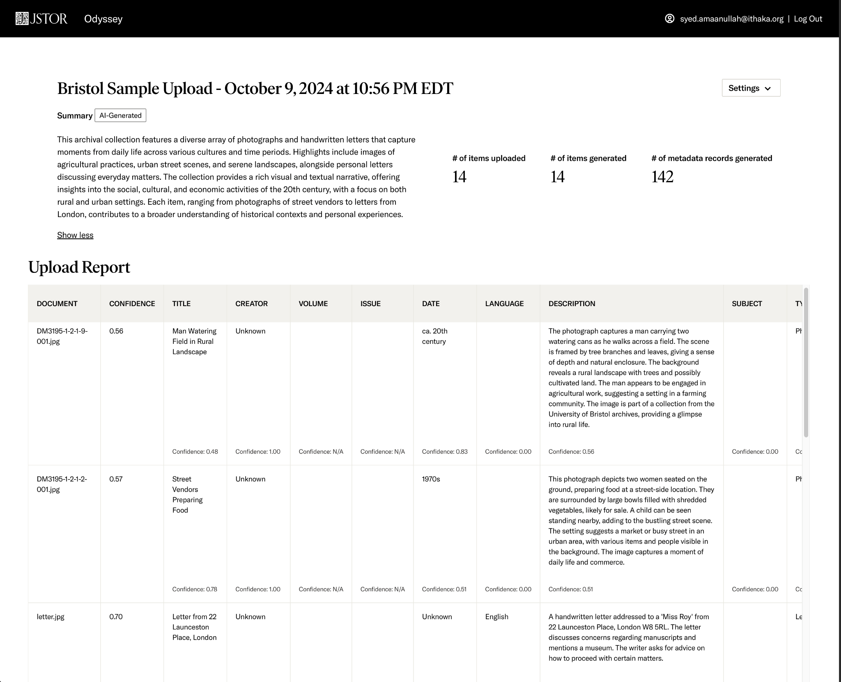
Notes:
Slide Presenter: Jason
Within a few brief moments, you are presented with a treasure trove of information and insights generated by the tool, Including an AI-generated descriptive summary of your entire upload that adequately summarizes and describes the collective relevance of all of the materials in your upload.
As well as robust and relevant item-level metadata in the Dublin Core schema for all of your items.

Slide 14
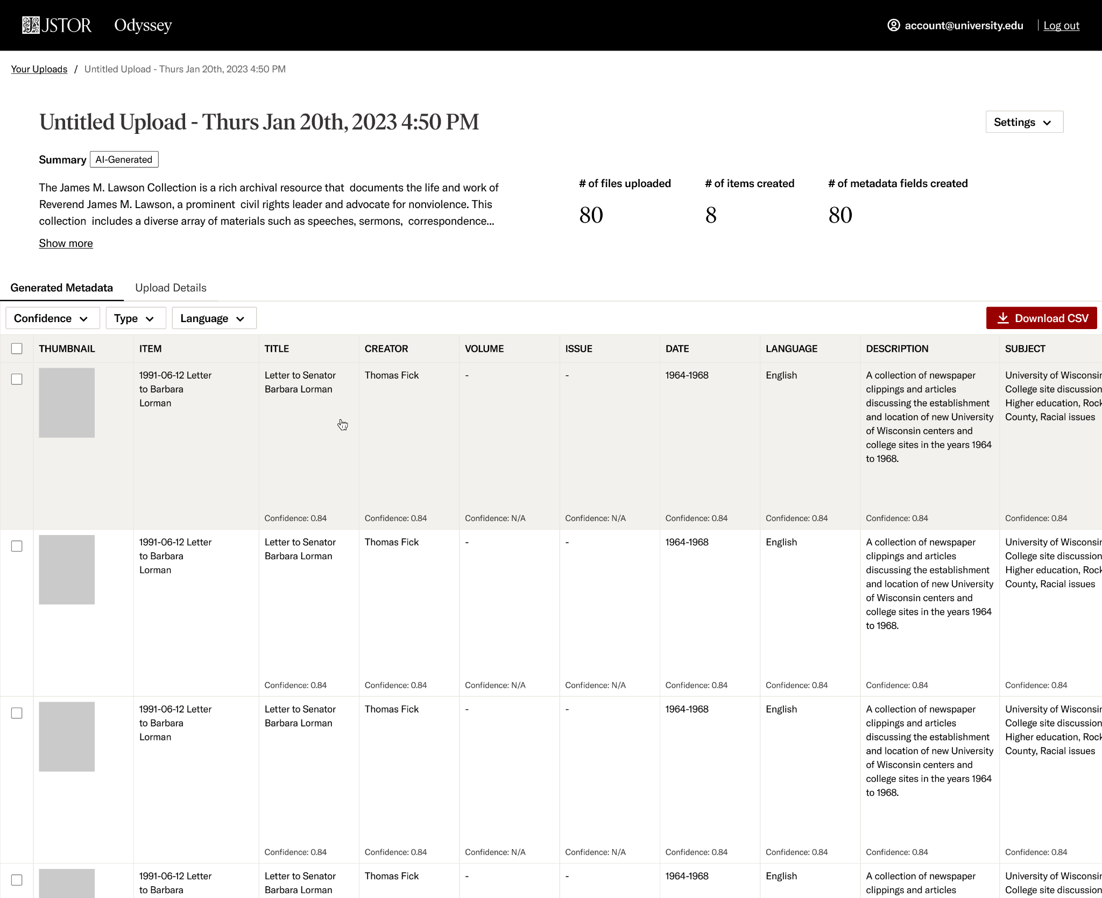
Notes:
Slide Presenter: Jason
We provide a confidence score for each field, and then aggregated for each item.
This confidence score is a statistical interpretation provided by our system to demonstrate how well it thinks it did in generating relevant and accurate metadata.
These confidence scores are meant to serve as contextual guidance for the real expert, the human in the loop, to review and approve the produced metadata. Next slide..

Slide 15
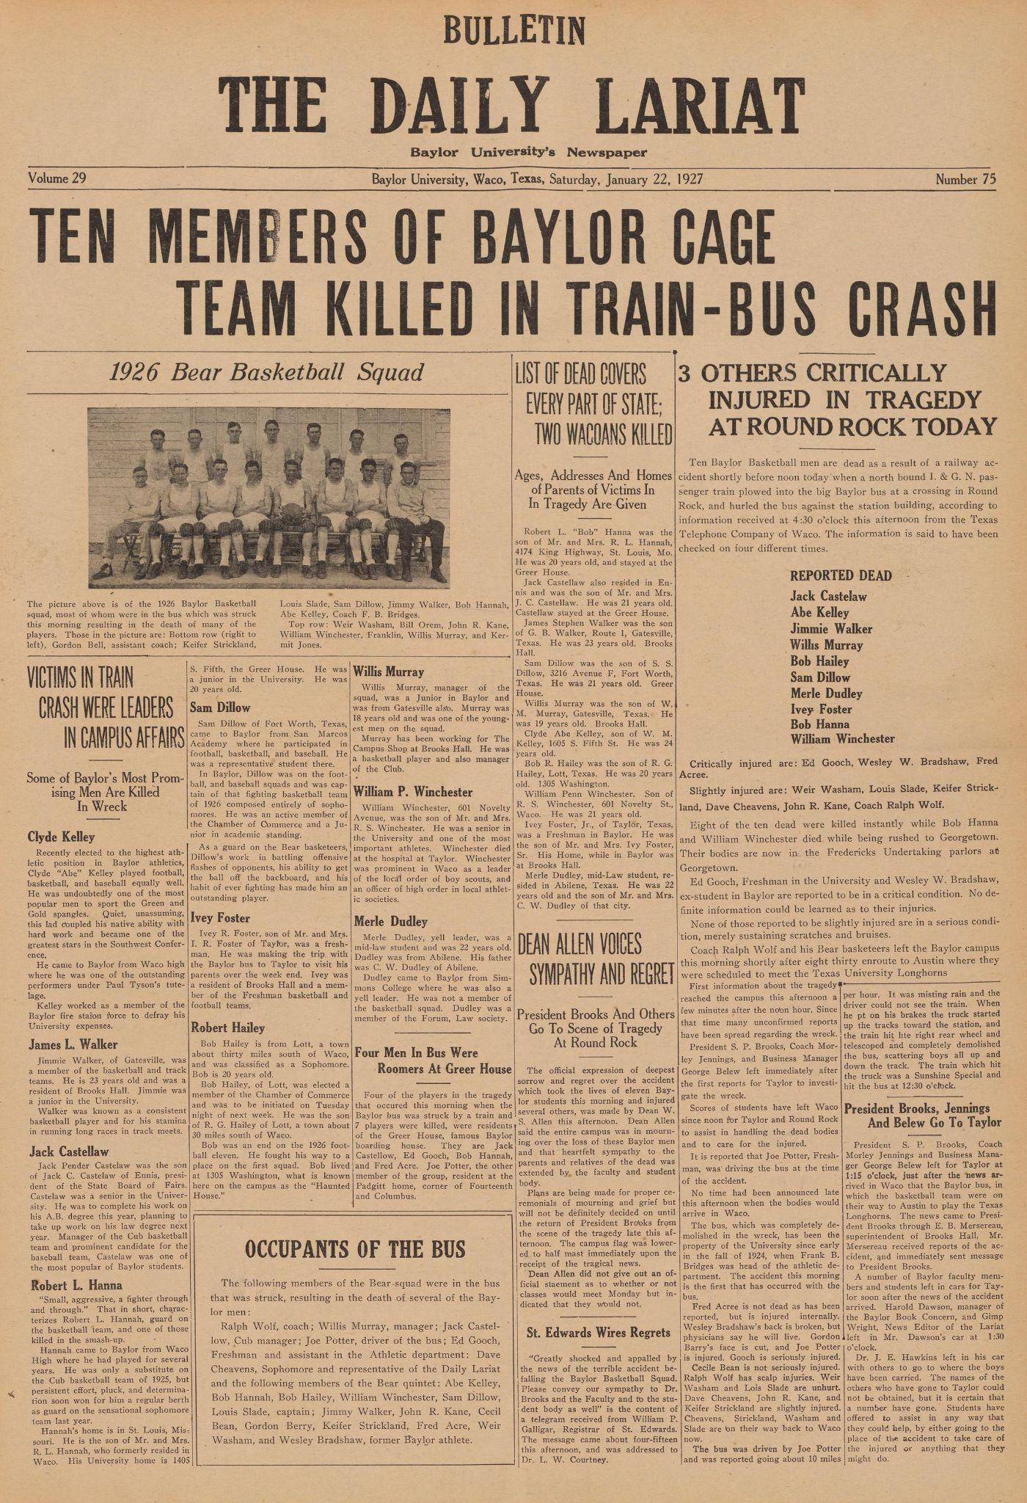

Creator | Baylor University Confidence: 0.98
Title | The Daily Lariat - Ten Members of Baylor Cage Team Killed in Train-Bus Crash Confidence: 0.80
Date | 1927-01-22 Confidence: 1.00
Description | This issue of The Daily Lariat, Baylor University's newspaper, reports on a tragic accident where ten members of the Baylor basketball team were killed in a train-bus crash in Round Rock, Texas. The article includes a list of the deceased, their backgrounds, and reactions from university officials. It also features a photograph of the 1926 Baylor Basketball Squad. The newspaper provides detailed coverage of the incident and its impact on the university community. Confidence: 0.70
Subject | Train accident, Basketball, Baylor University, Tragedy, Sports Confidence: 0.80
Publisher | Baylor University Confidence: 0.99
Language | English Confidence: 1.00
Notes:
Slide Presenter: Jason
Now, let’s take a look at some examples of what the system is able to produce. As you can see, we have the front page of The Daily Lariat, Baylor University’s newspaper, from January 22, 1927. The collections processing tool has done a great job of extracting the information that’s readily apparent in the text itself, such as the Date, publisher and so on. And, if you read the description, you can start to get a sense of how the system is deriving meaning from that text and representing it in a way that an archivist or librarian might.

Slide 16

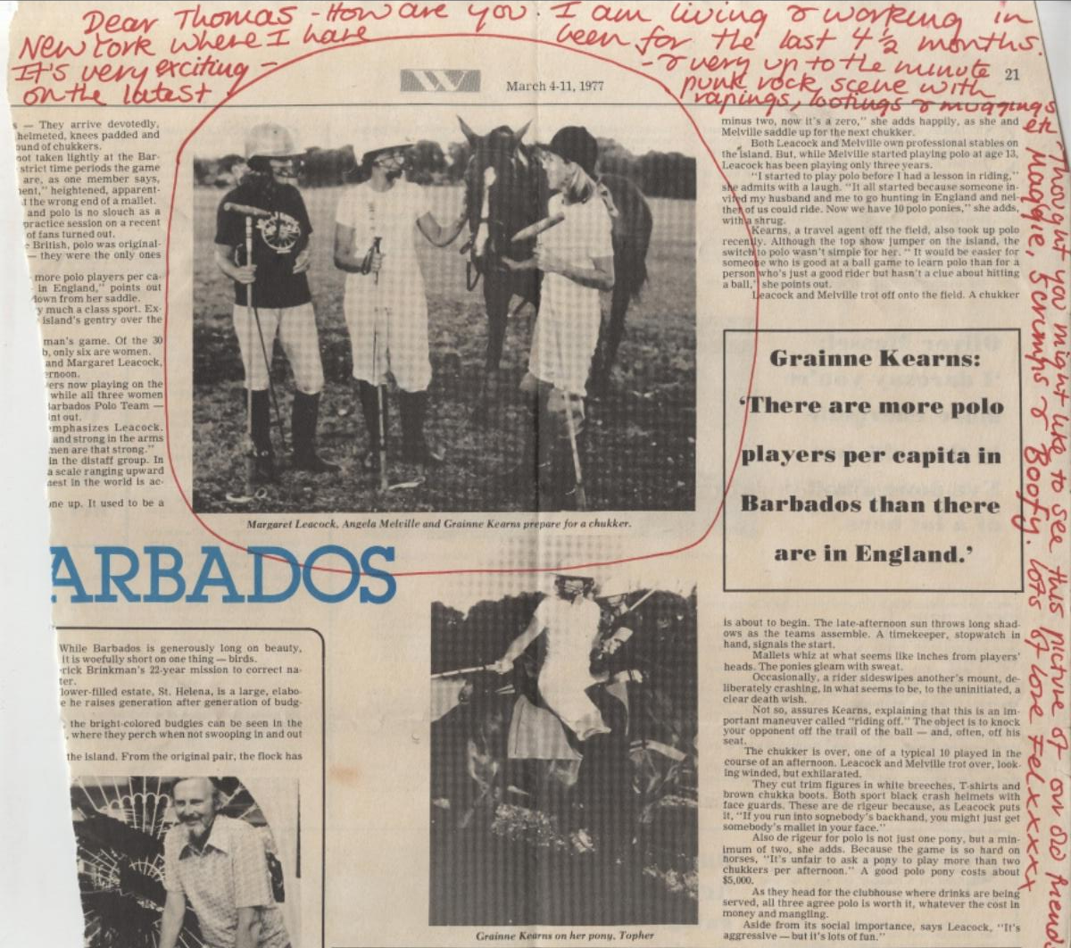
Creator | Unknown Confidence: 0.99
Title | Barbados Polo Article with Annotations Confidence: 0.56
Date | 1977-03-11 Confidence: 0.98
Type | Newspaper Article Confidence: 0.57
Description | A newspaper article from March 11, 1977, discussing the popularity of polo in Barbados compared to England. The article is titled 'Grainne Kearns: There are more polo players per capita in Barbados than there are in England.' It includes photographs of polo players and is annotated with handwritten notes addressed to 'Thomas' from 'Fel.' The notes express personal sentiments and mention a shared interest in polo. Confidence: 0.67
Coverage | style: Journalistic, culture: British, period: 1970s, location: Barbados Confidence: 0.94
Publisher | Unknown Confidence: 0.90
Language | English Confidence: 1.00
Notes:
Slide Presenter: Jason
let’s take a look at another example that’s a bit more complex. here we have a newspaper clipping that has been annotated by hand. And, the description provided by our systems accurately discerns between the article text and the annotation, saying “it includes photographs of polo players and is annotated with handwritten notes addressed to ‘Thomas’ from ‘Fel’. The notes express personal sentiments and mention a shared interest in polo.’
Next slide

Slide 17
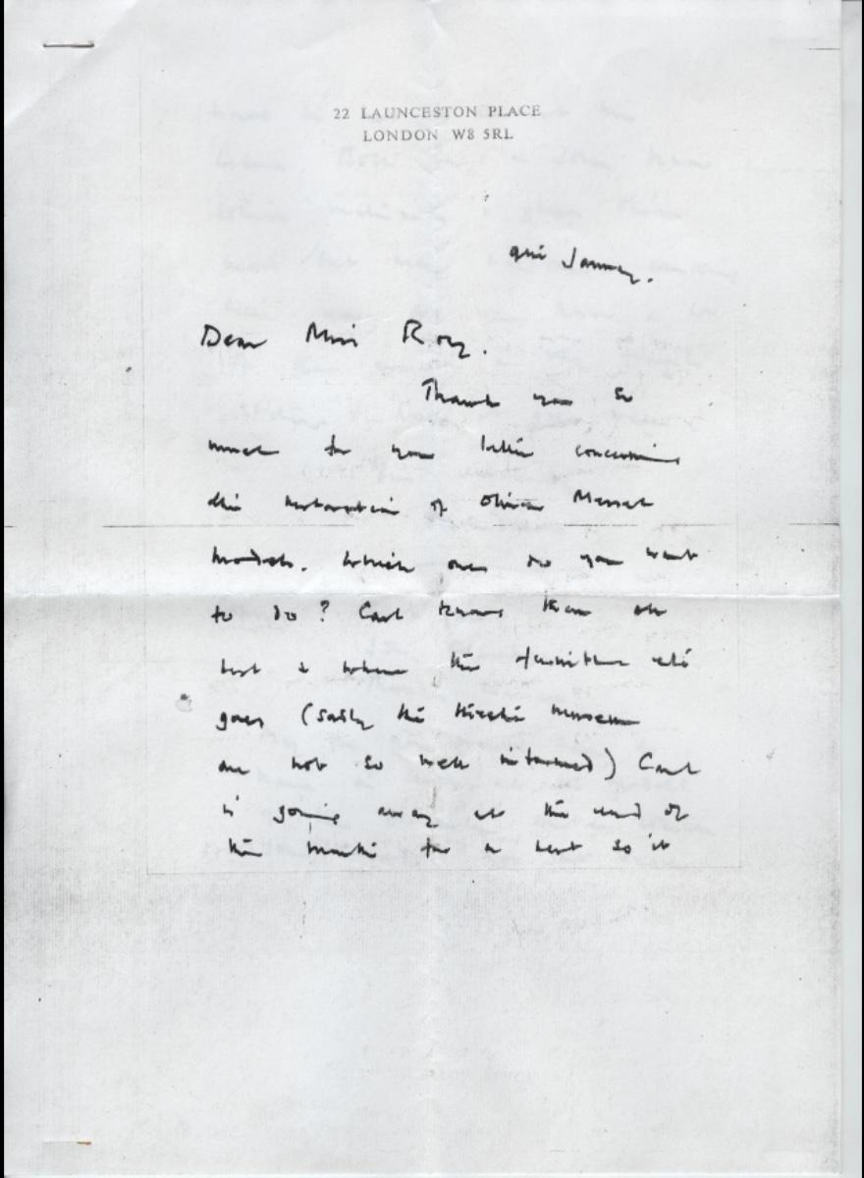
Creator | Unknown Confidence: 1.00
Title | Letter Regarding Manuscript and Museum Concerns Confidence: 0.44
Date | Unknown Confidence: 0.56
Type | Letter Confidence: 0.57
Description | This is a handwritten letter addressed to a 'Miss Roy,' originating from 22 Launceston Place, London. The letter discusses matters related to manuscripts and museum holdings, particularly mentioning the 'Hamilton el's' and 'Hirsch museum.' The writer seeks advice on what actions to take concerning these issues. The context suggests a discussion about the management or disposition of manuscripts and museum collections. Confidence: 0.49
Coverage | style: Epistolary, culture: British, period: 20th century, location: London, England Confidence: 0.85
Language | English Confidence: 1.00
Notes:
Slide Presenter: Jason
Ok, great. But how well does it perform with handwriting that might be a challenge for the human eye? Well, if you take a look at this example, you’ll see that for most of us it is difficult to make out much of the text in this handwritten letter, let alone be able to derive some comprehensible meaning. In the metadata record that’s been generated you will see that our system was able to produce relatively robust metadata for this record, with the description reading “This is a handwritten letter addressed to a 'Miss Roy,' originating from 22 Launceston Place, London. The letter discusses matters related to manuscripts and museum holdings, particularly mentioning the 'Hamilton el's' and 'Hirsch museum.' The writer seeks advice on what actions to take concerning these issues. The context suggests a discussion about the management or disposition of manuscripts and museum collections.”

Slide 18

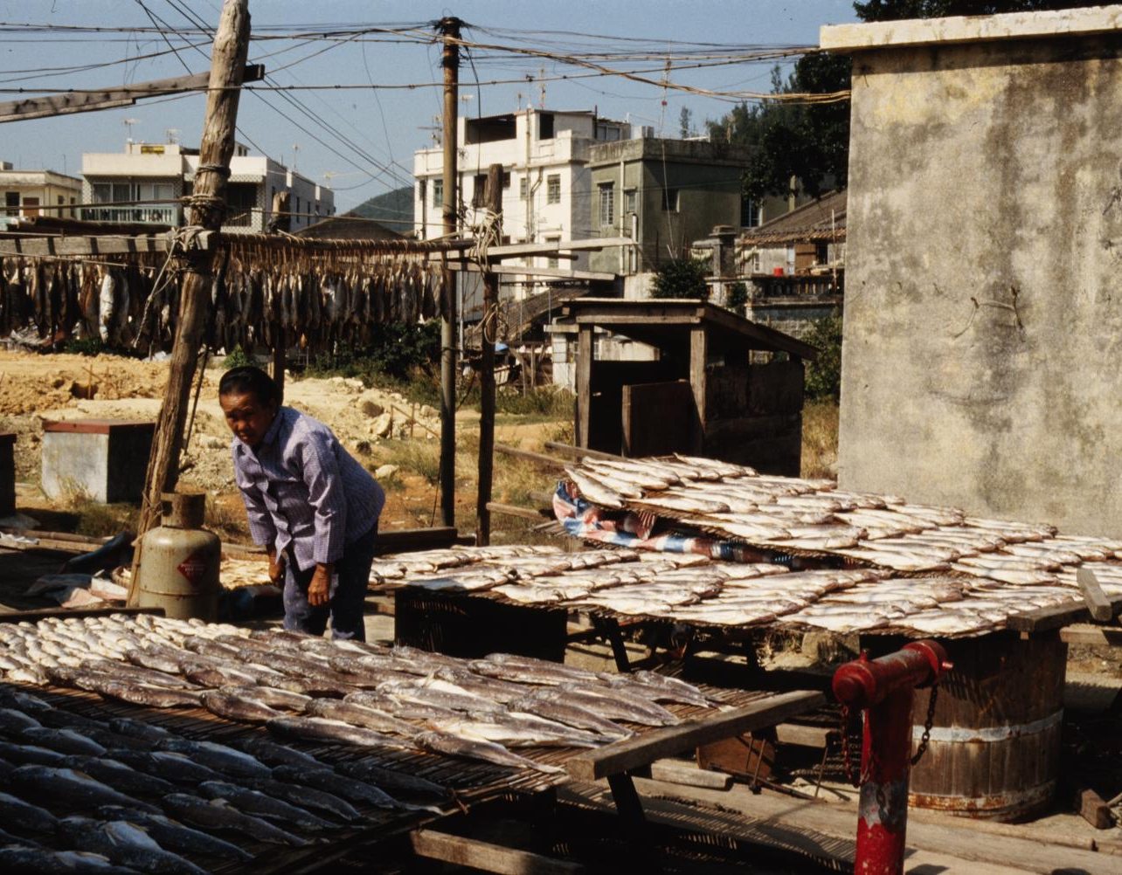
Creator | Unknown Confidence: 1.00
Title | Fish Drying Process in Urban Setting Confidence: 0.72
Date | ca. 1970s Confidence: 0.76
Type | Photograph Confidence: 0.98
Description | The image depicts a scene of fish drying in an urban area, likely in an Asian city during the 1970s. A person is seen tending to rows of fish laid out on wooden racks under the sun. In the background, there are residential buildings, suggesting a blend of traditional and modern practices. The setting includes hanging fish and an outdoor setup typical of small-scale fish processing. The presence of a gas cylinder suggests some level of modernization in the process. Confidence: 0.50
Coverage | style: Documentary, culture: Asian, period: 20th century, location: Asia Confidence: 0.92
Publisher
Language
Notes:
Slide Presenter: Jason
How about images? As you can see in this photograph, there is no text for the system to extract and derive meaning from, yet it’s able to create a title “Fish Drying Process in Urban Setting”, date, description and more. You may have noticed that some fields are blank and you might be thinking, “What happened? Did the system fail?”. And the answer is “no”, this is by design. We have engineered constraints around the AI to prevent or reduce hallucinations. Our guardrails work to ensure that the technology does not create information out of thin air without any reasonable justification, thereby maintaining the integrity of metadata.

Slide 19
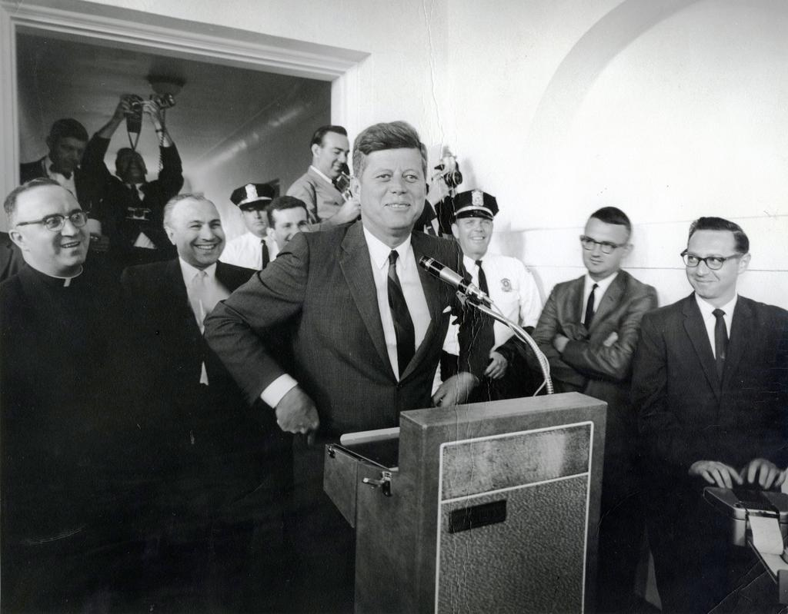
Creator | Unknown Confidence: 1.00
Title | John F. Kennedy at a Public Speaking Event Confidence: 0.52
Date | 1960s Confidence: 0.95
Type | Photograph Confidence: 1.00
Description | A photograph of John F. Kennedy speaking at a podium with a group of men, including a priest and several photographers, in the background. Confidence: 0.57
Subject | John F. Kennedy, Public Speaking, 1960s, Politics, Photography
Coverage | style: Documentary, culture: American, period: Mid-20th century, location: United States Confidence: 0.87
Language | English
Notes:
Slide Presenter: Jason
We are also able to not only recognizes when humans are in an image, but to identify those humans if they happen to be a well-known historical figure or contemporary personality as you can see here in this image of John F. Kennedy.

Slide 20
How does it work?
Upload text documents
Text is extracted (OCR)
Images, OCR, and prompt sent to LLM
(GPT-4o)
LLM generates metadata suggestions
Metadata suggestions presented to user for review
Upload images
Images are classified
Facial recognition & other processes are executed on the images
Images plus contextual information are sent to LLM (GPT-4o) along with a specialized set of prompts
Metadata suggestions presented to user for review
Notes:
Slide Presenter: Jason
Ok, great. So, how does it work? I’m glad you asked. It’s important to note that each format type requires its own unique configuration of technologies in order to generate the high-quality metadata that you’ve seen here today. For text documents, this means that we are running optical-character-recognition on those materials, and then sending snapshots of the documents, the OCR’d text and highly-specialized instructions to the LLM for processing.
With images, we first classify the images into types, identifying if there are any humans and applying facial recognition to identify historical figures and celebrities before sending all of that information, along with specialized instructions to the LLM for processing. Next slide…

Slide 21

Time Savings
1500 docs
Now takes ~1.4 hrs
268x faster
With our current tool (which is getting faster!)
375 hours of work
(1 FTE for 9.5 weeks)
Currently it takes someone an average of 15 min per doc to create metadata at the item level
Notes:
So returning to why we started this work
Libraries have a large and growing backlog of digital materials that they don’t have the time to process - backlogs measured in years
Meaning these materials can’t be preserved for the long term or made accessible for discovery and use by students and scholars
This is where we think this tool can have the greatest impact.
For example, it could take 1 full time employee 9 ½ weeks for 375 hours to process the metadata for 1500 items. With our tool, which can handle uploads in bactches of 1000 items, it would take the same person 1 hour and 15 minutes to get records generated.

Slide 22


Thank you.
Thank you for joining our session. Let’s continue the conversation--drop by our PULINET booth for a chat! We look forward to discussing the new ways ITHAKA and JSTOR can support your library.
Your partners at ITHAKA
JSTOR | Constellate | Artstor | Portico | Ithaka S&R
Notes:
Slide: Conclusion and call to action
Slide Time: 3-minutes
Slide Presenter: Javanica
This concludes my overview of our collections processing tool and the services we have available to help you manage your special collections whether they are theses and dissertations, rare books, or other content unique to your institution. You can use the QR code to let us know if you are interested in learning more. You can also stop by our table here at the conference.

