Slide 1
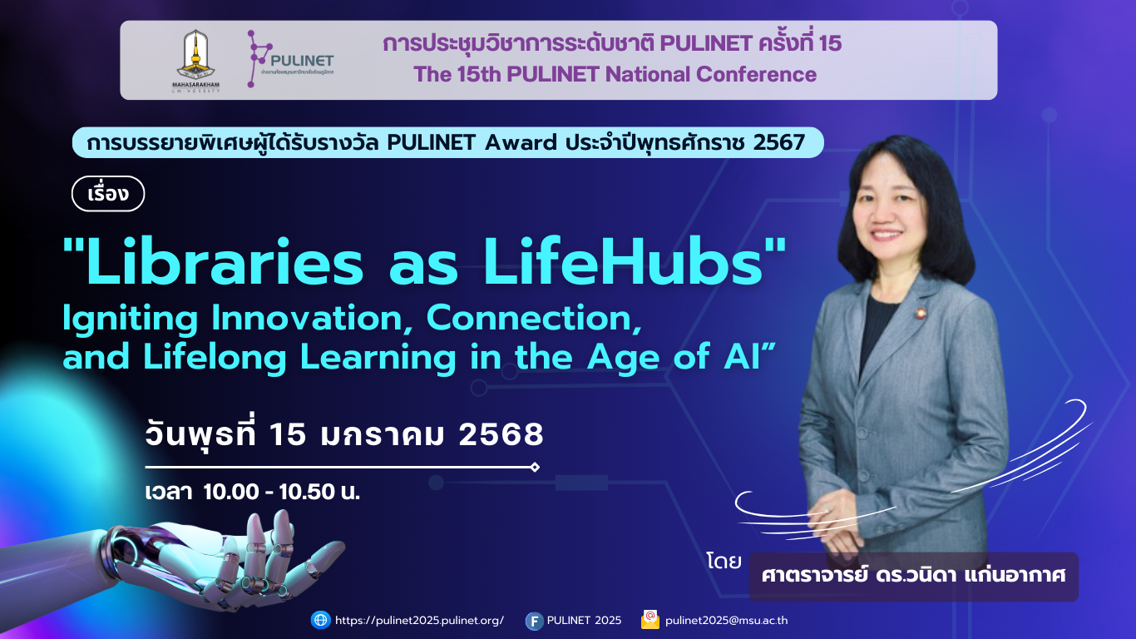

Slide 2
มากกว่าหนังสือคือพื้นที่ชีวิต

Slide 3

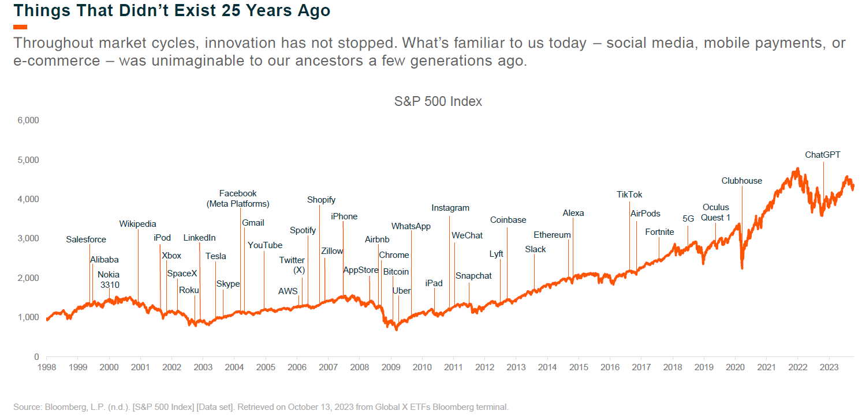

Slide 4
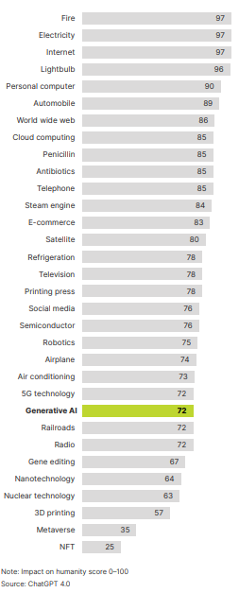
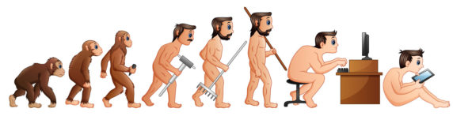
Generative AI is changing Everything,
Everywhere,
All at once
24.Generative AI
Source: https://www.creativefabrica.com/wp-content/uploads/2022/04/26/Cartoon-Human-Evolution-Graphics-29636641-1-1-580x386.jpg

Slide 5
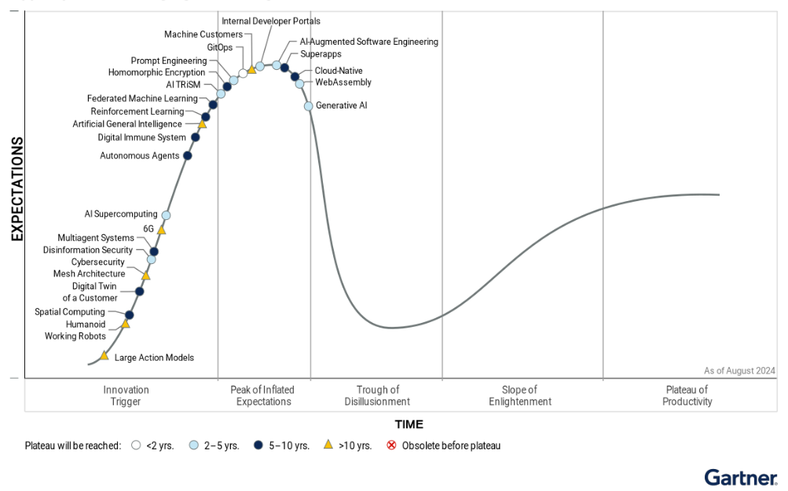
Generative AI

Slide 6
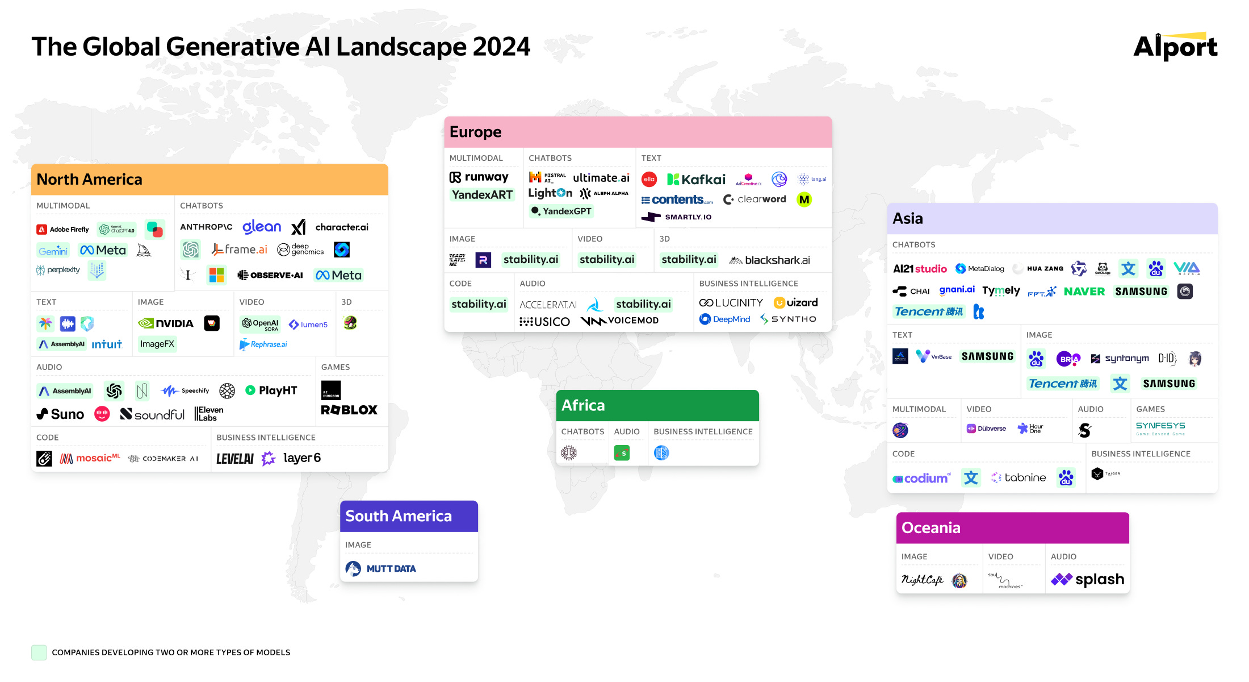

Slide 7
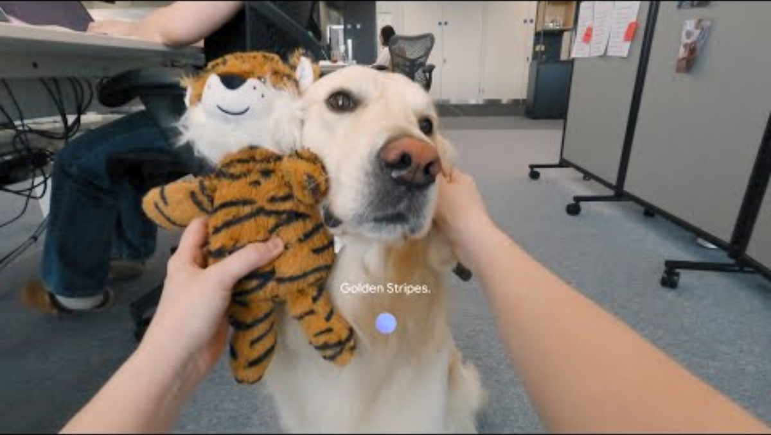

Slide 8
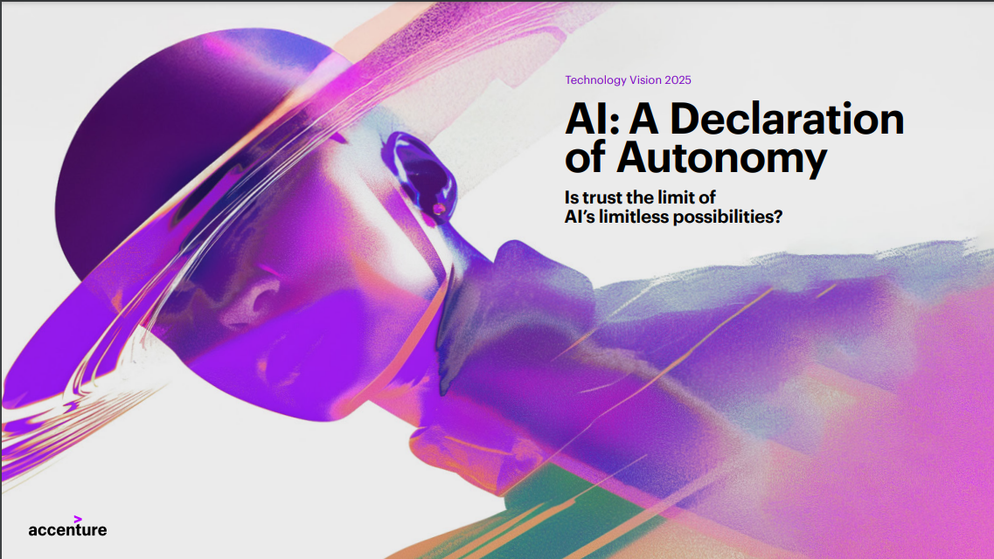

Slide 9
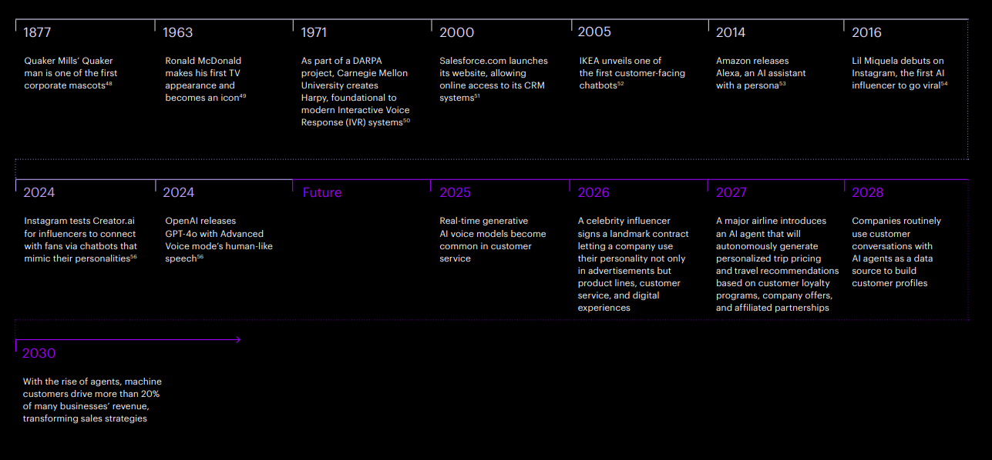
Your Face, in the Future

Slide 10
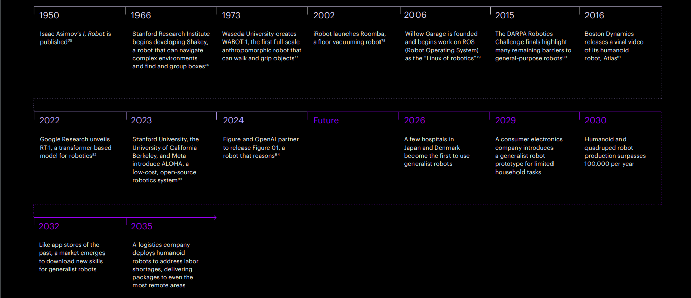
When LLMs get their Bodies

Slide 11
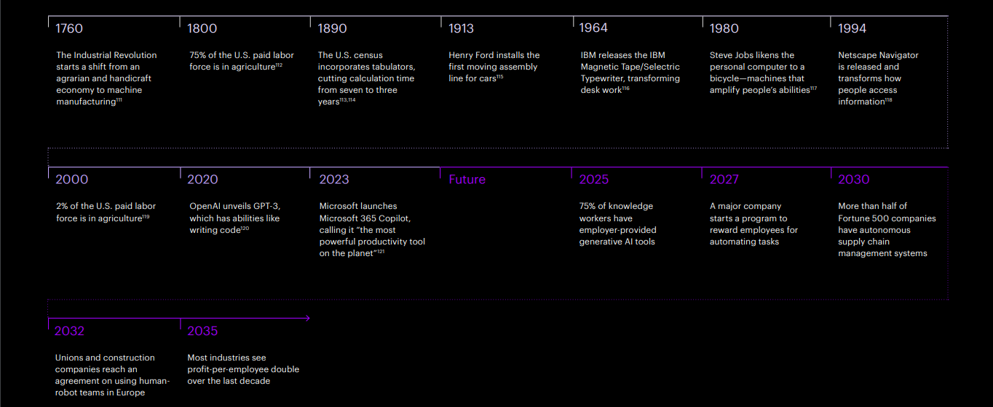
The New Learning Loop

Slide 12
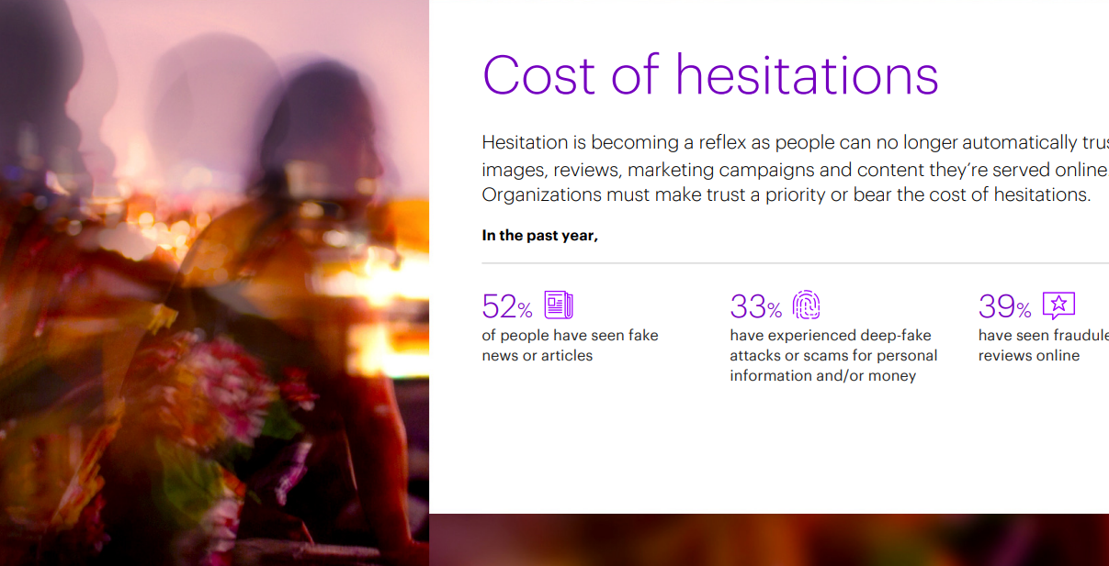

Slide 13
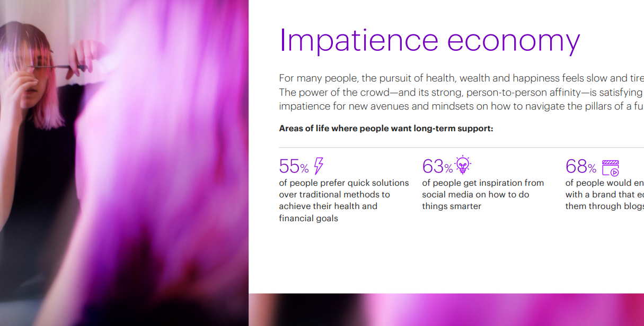

Slide 14
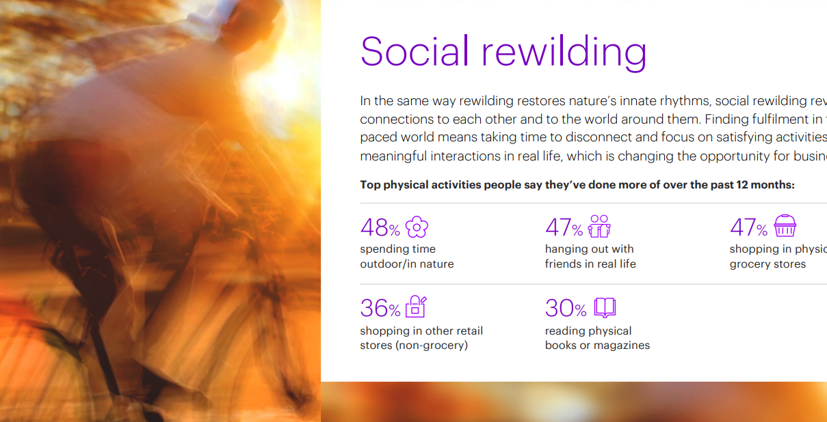

Slide 15
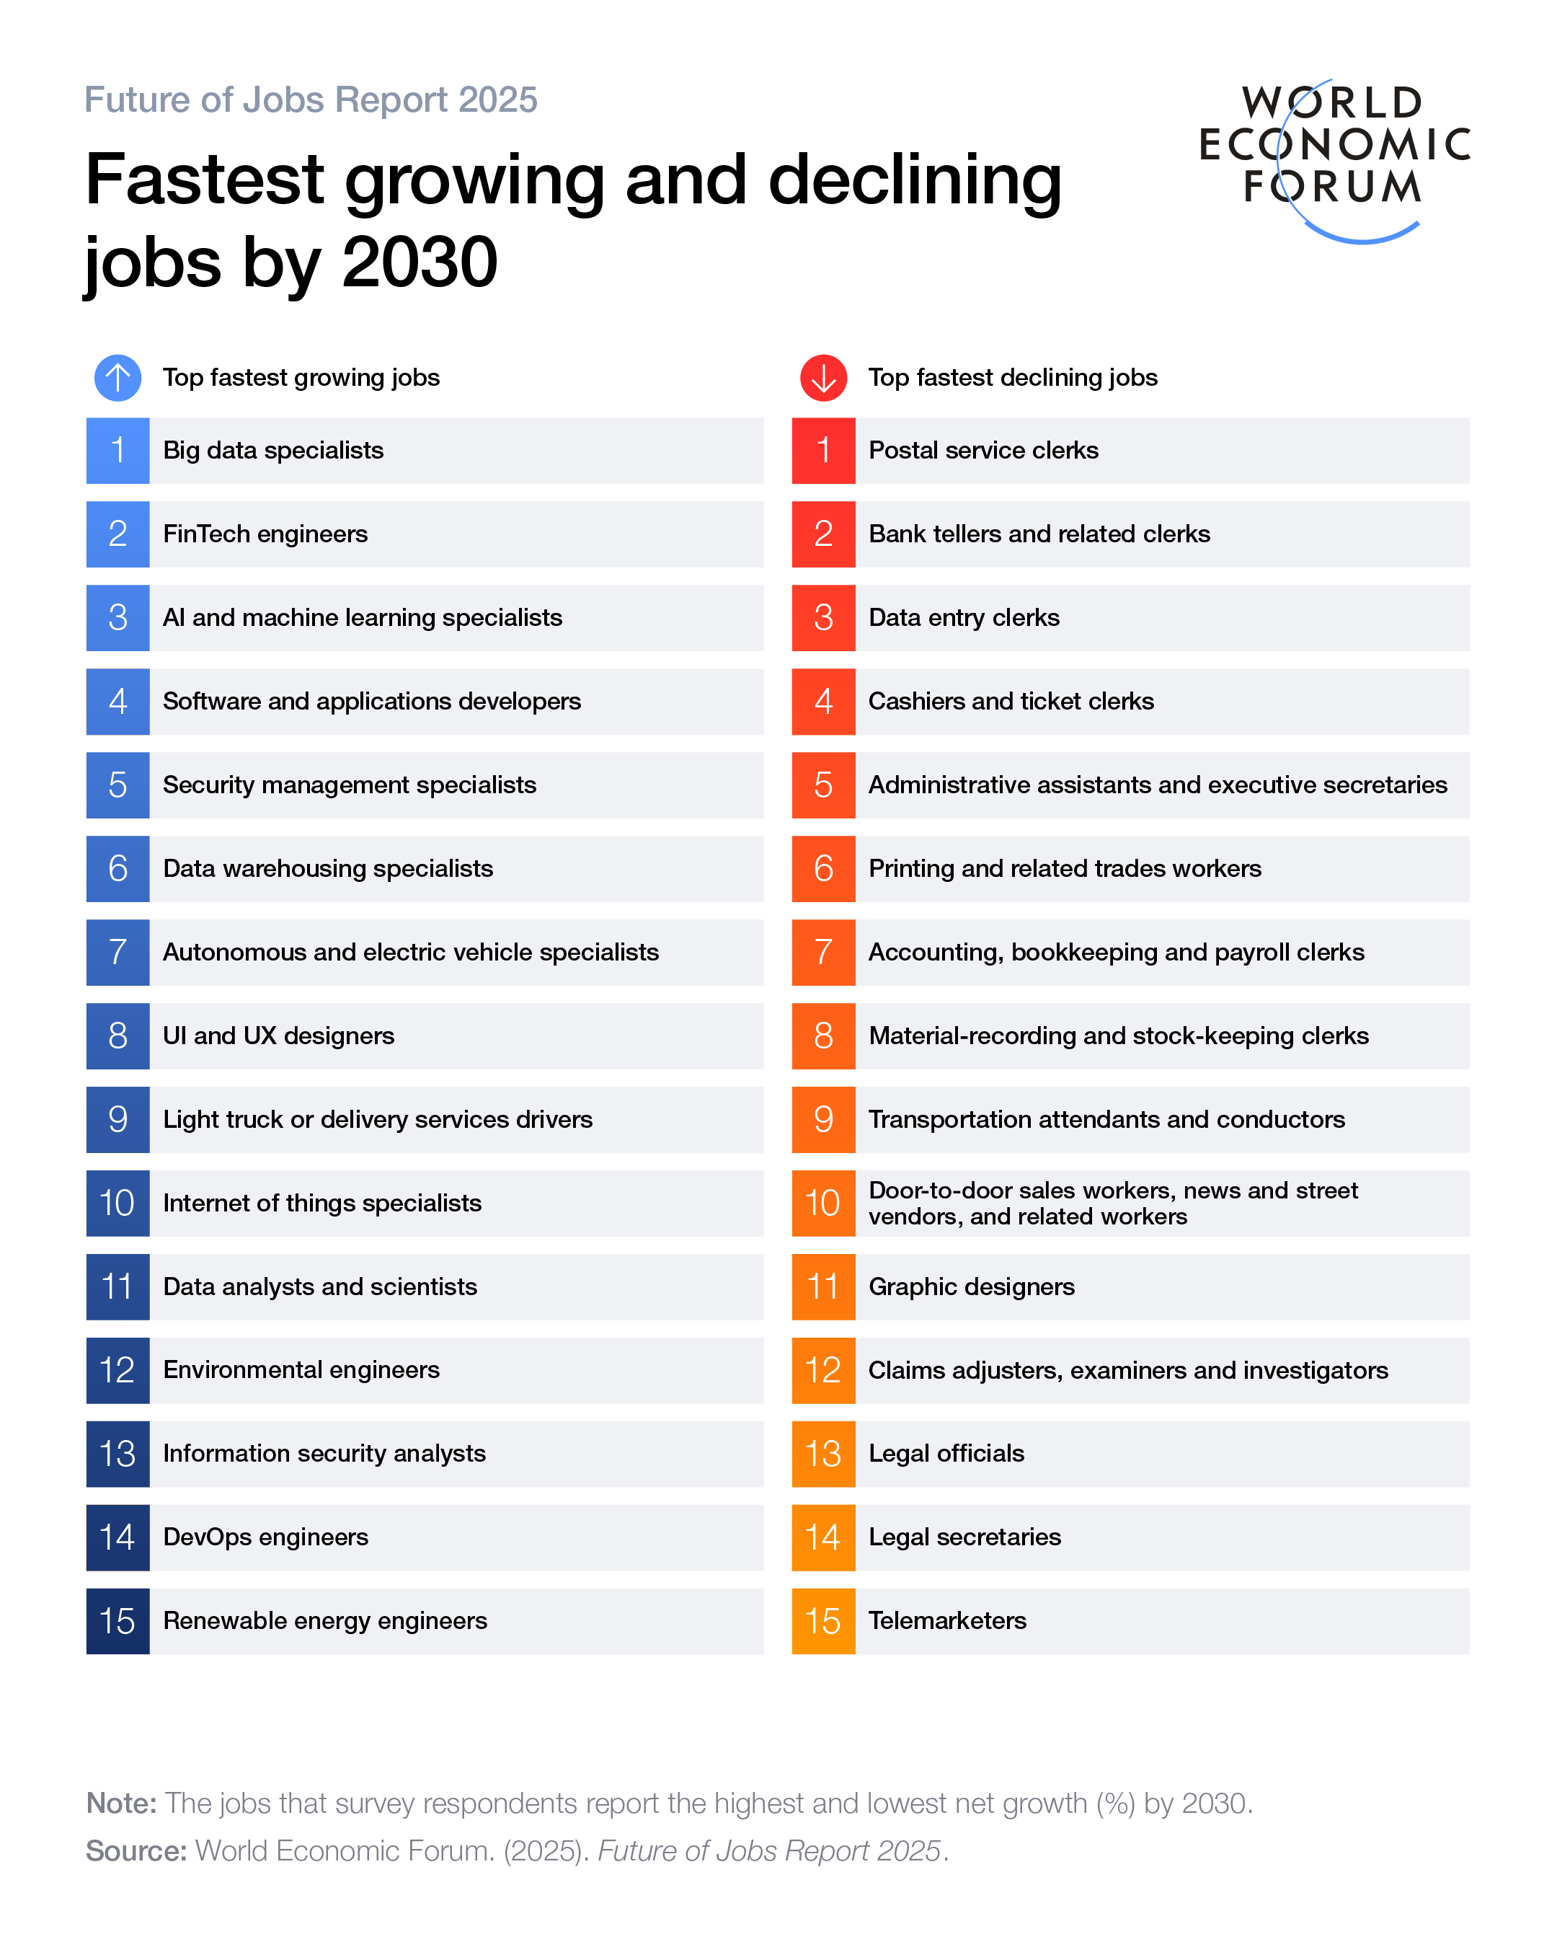
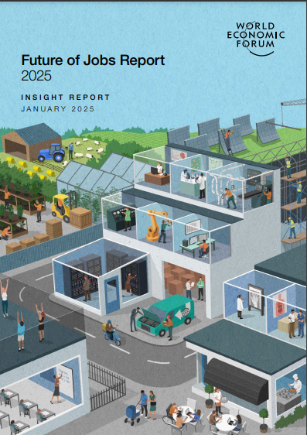

Slide 16
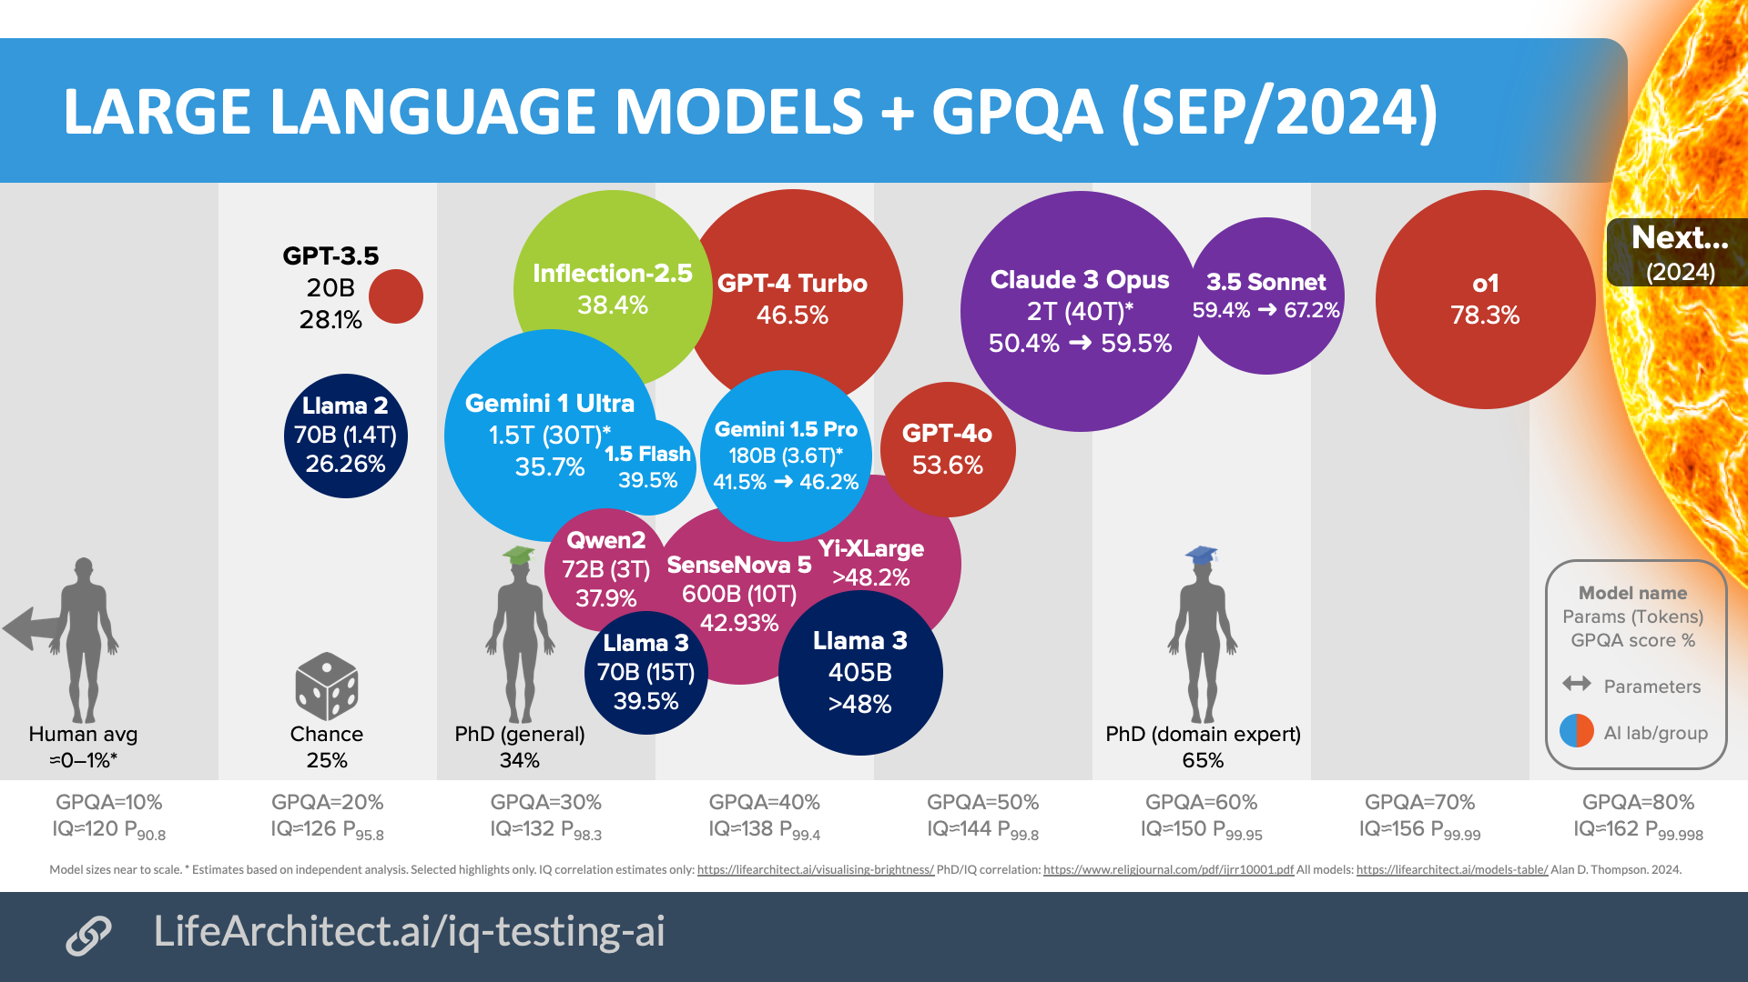

Slide 17
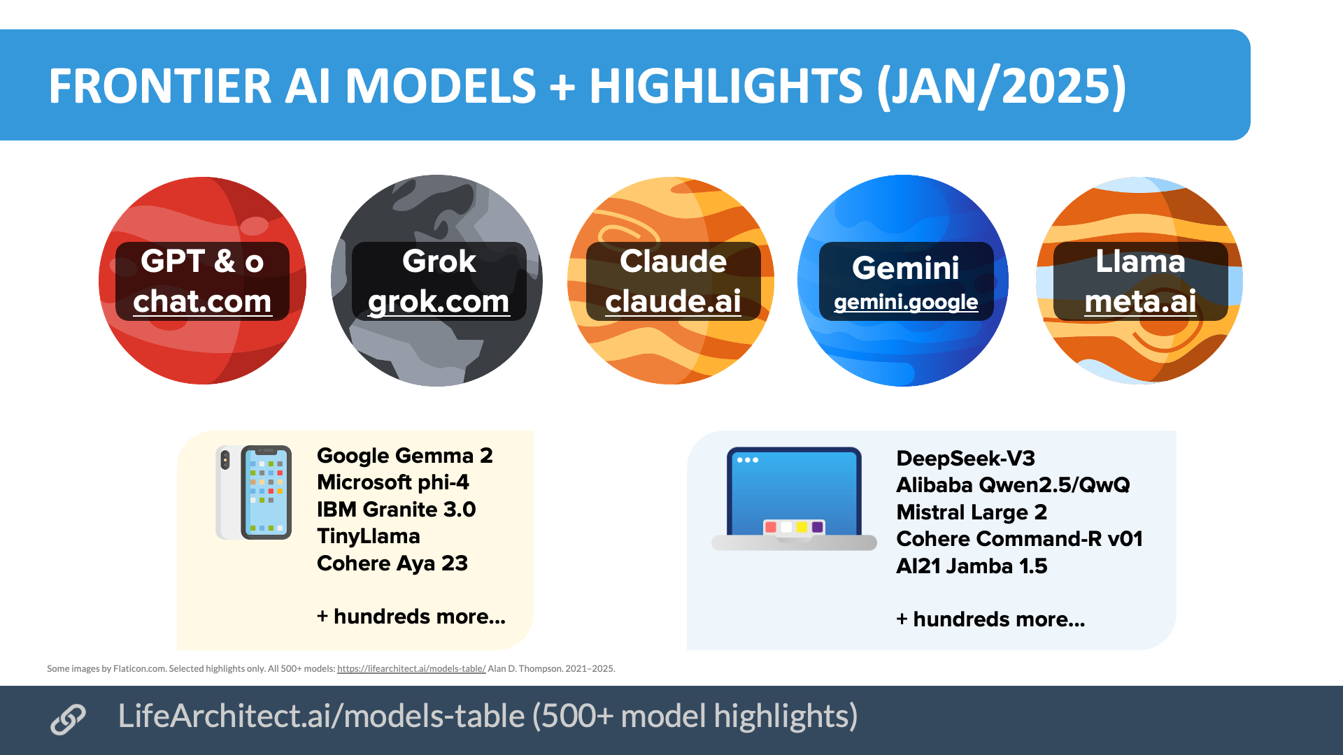

Slide 18
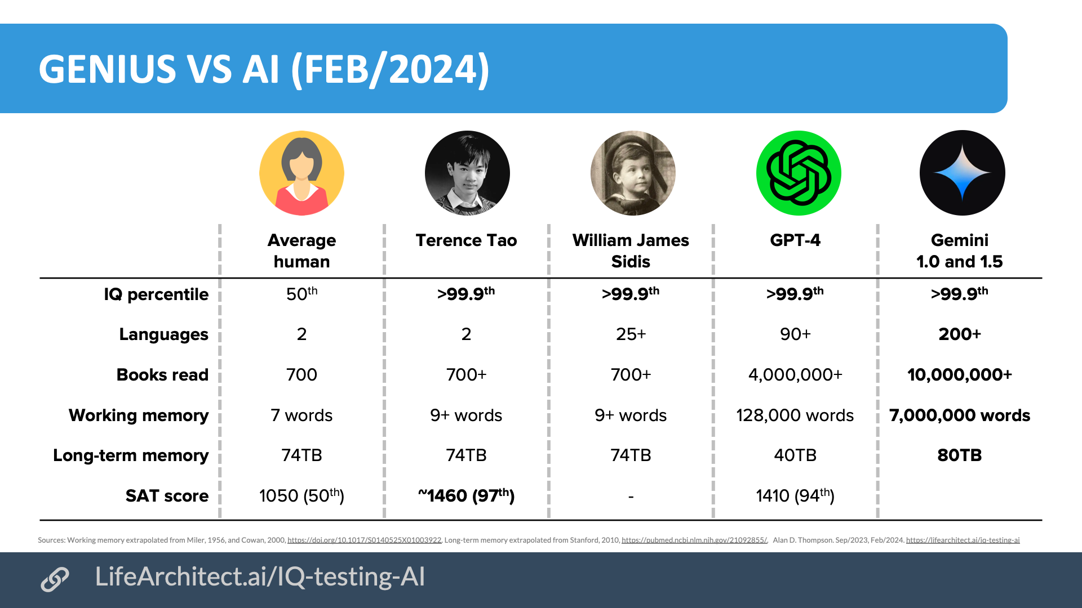

Slide 19
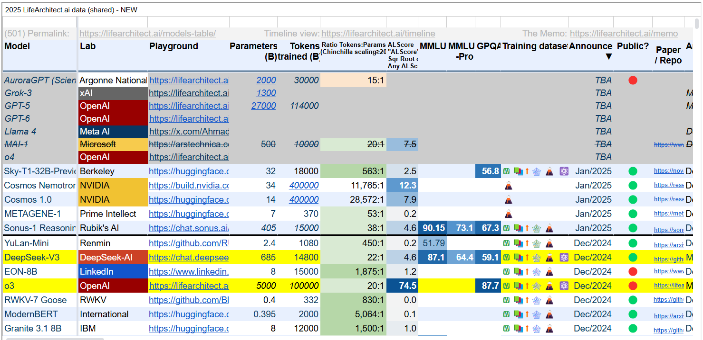

Slide 20
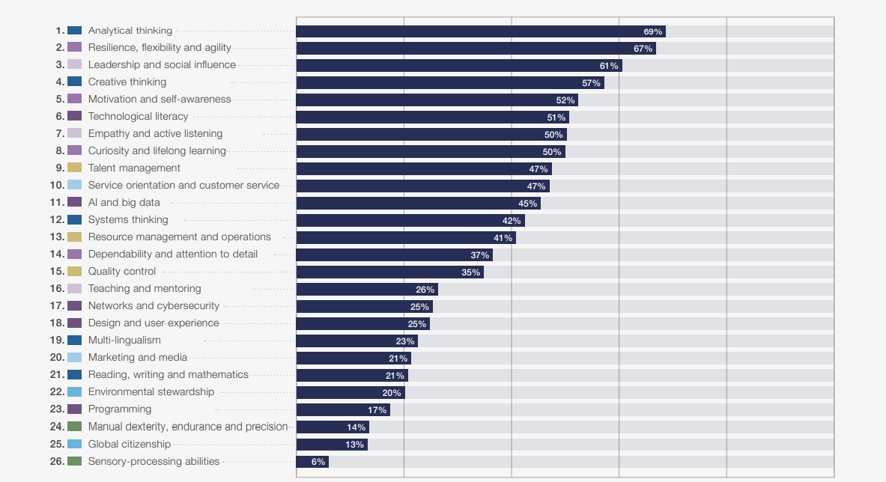
Core skills in 2025

Slide 21
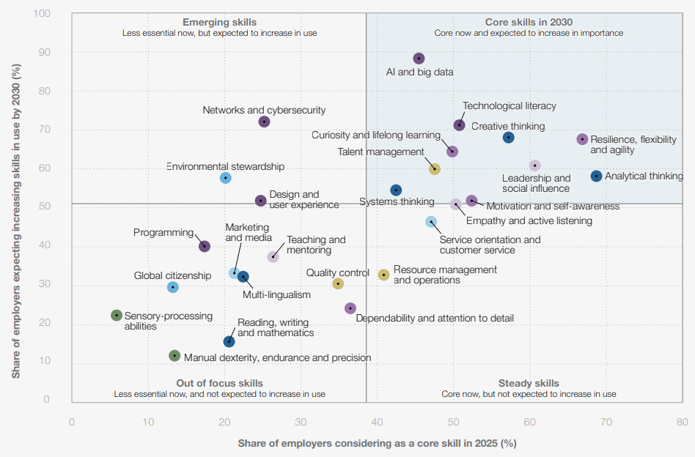

Slide 22
Core skills in 2025

Slide 23
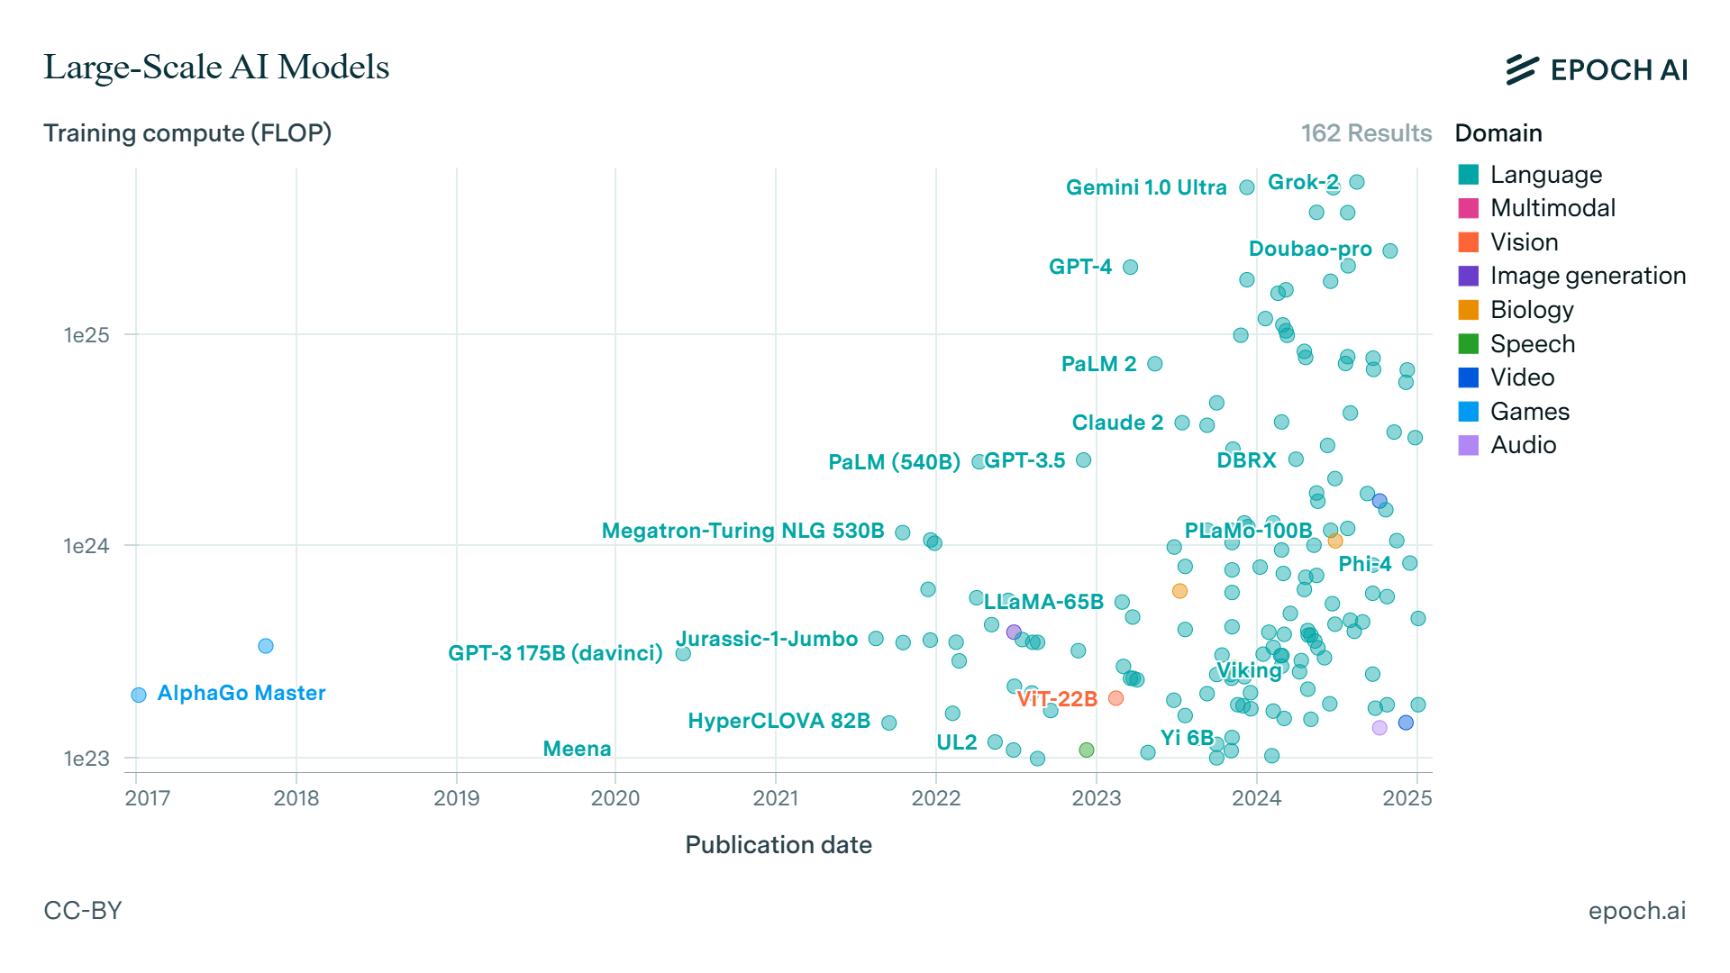

Slide 24
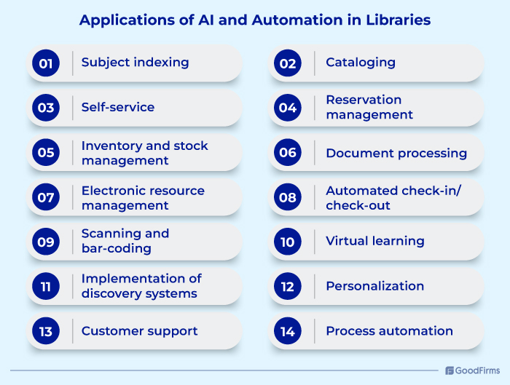

Slide 25
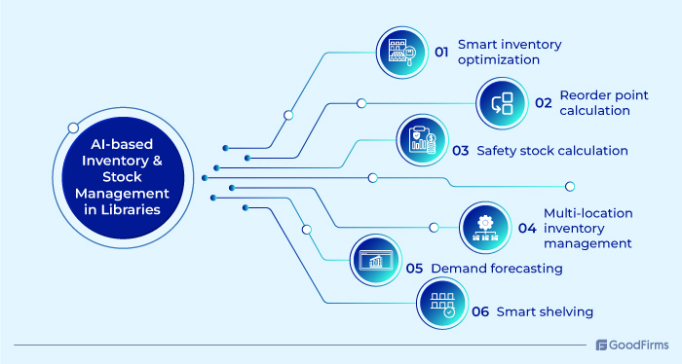

Slide 26
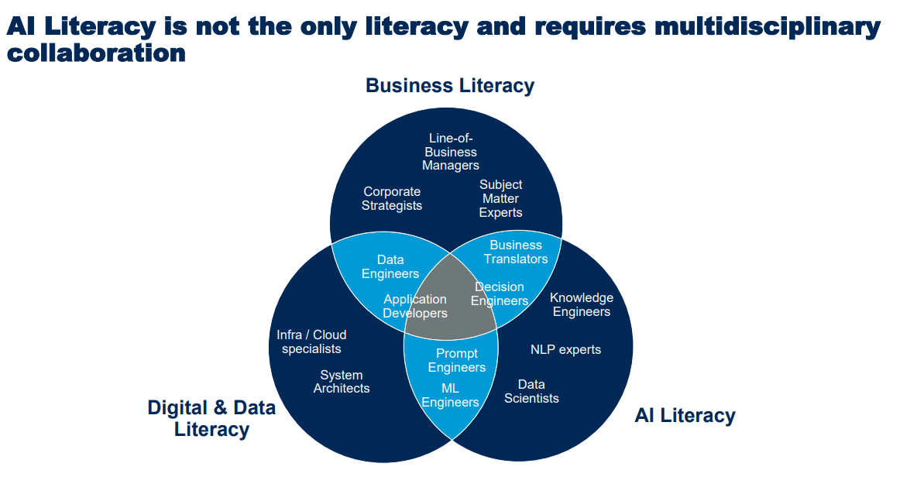

Slide 27
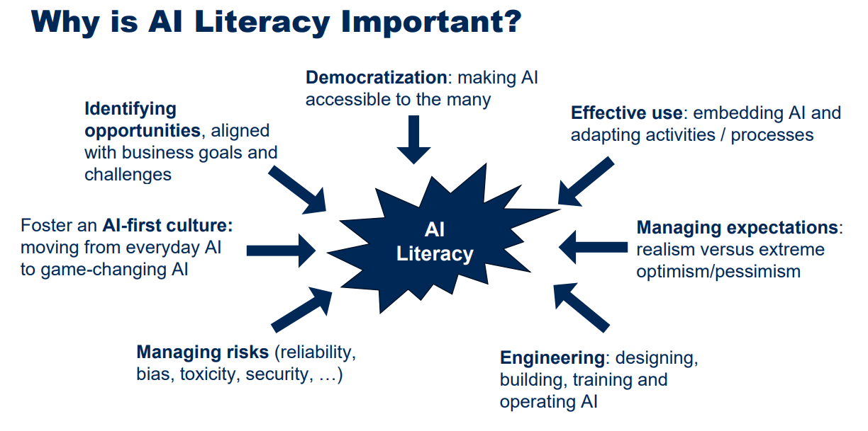

Slide 28
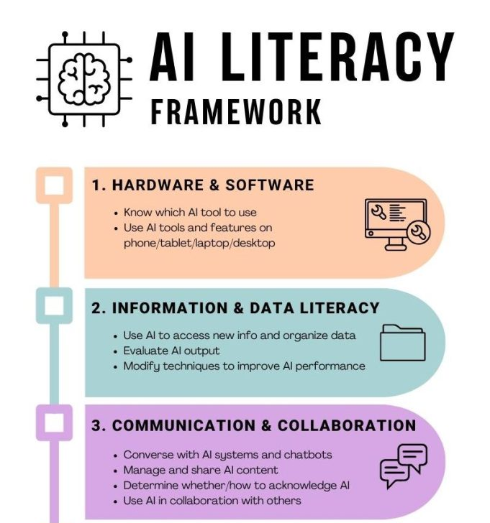


Slide 29
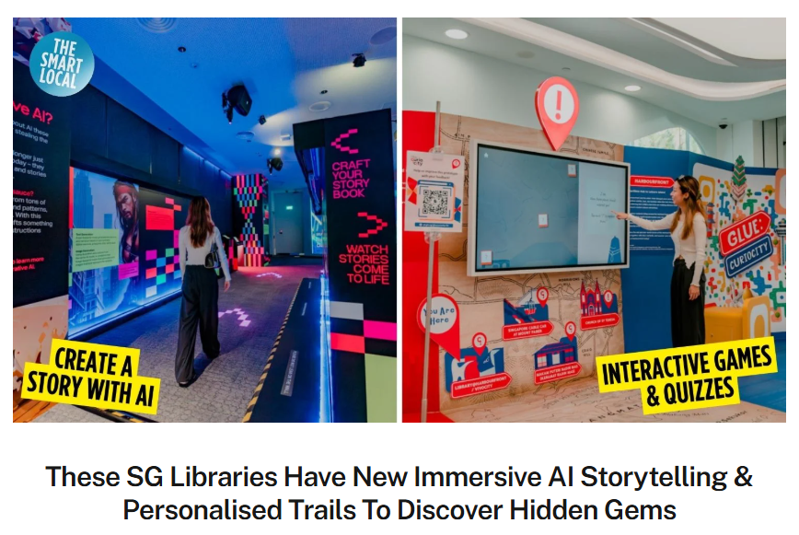
https://thesmartlocal.com/read/national-library-board-new-offerings-2024/

Slide 30
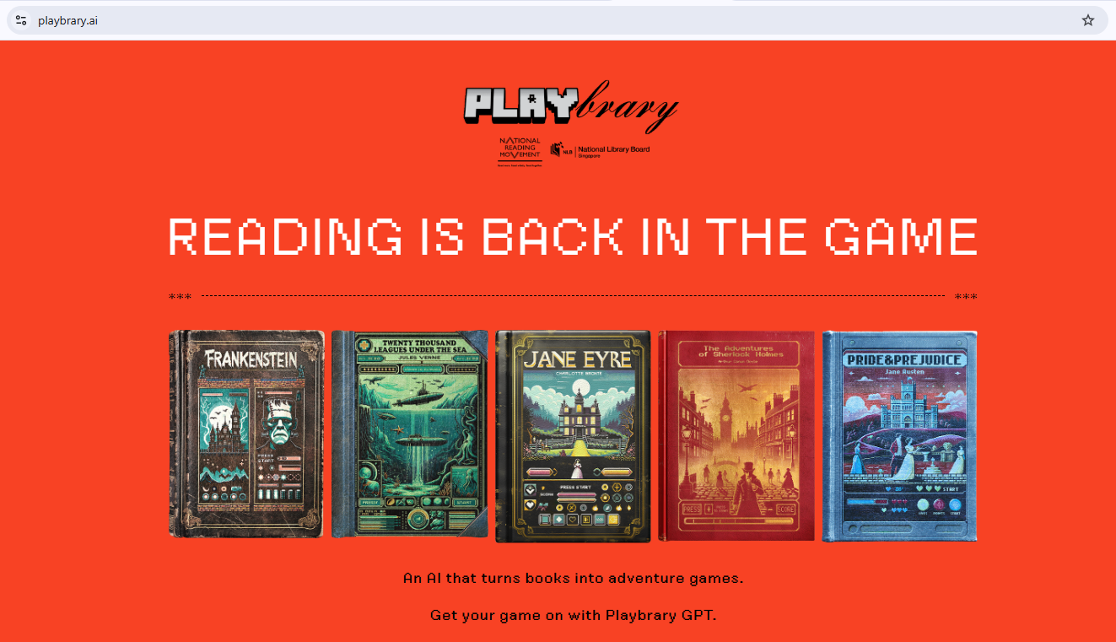

Slide 31
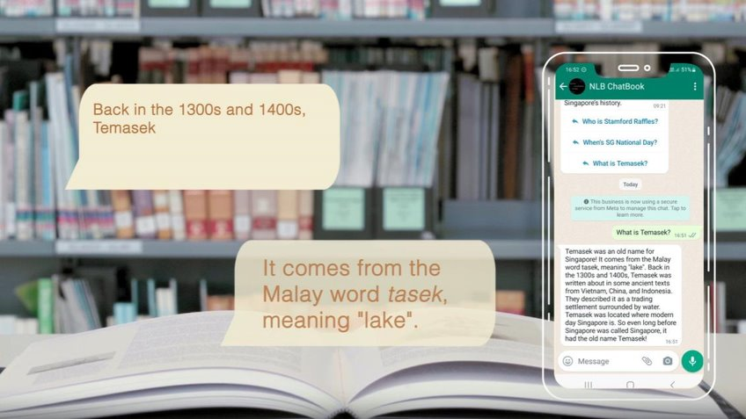
National Library (NL) : Chatbook

Slide 32
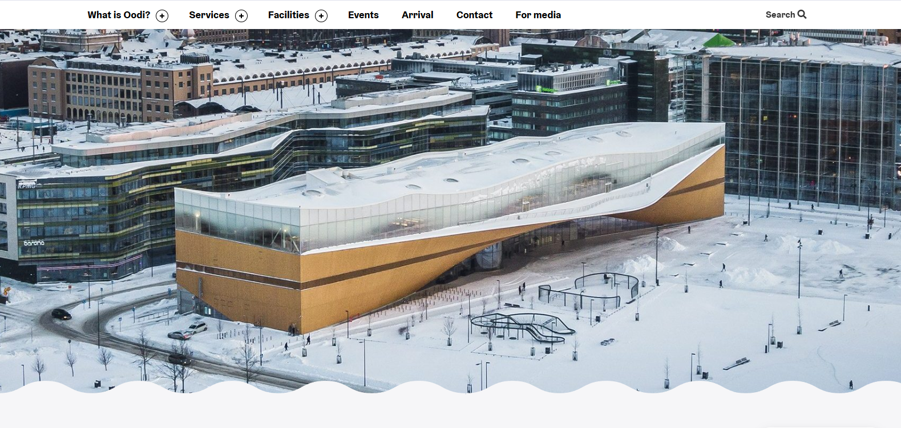
Oodi: Helsinki Central Library
Oodi provides its users with knowledge, new skills and stories, and is an easy place to access for learning, story immersion, work and relaxation. It is a library of a new era, a living and functional meeting place open for all.
https://oodihelsinki.fi/en/

Slide 33
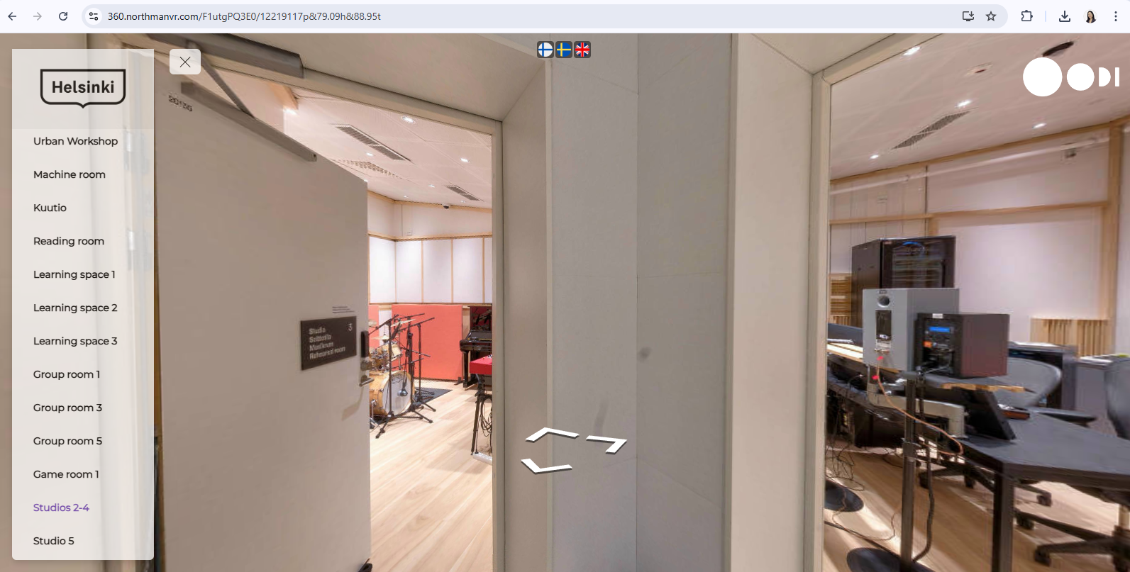
https://360.northmanvr.com/F1utgPQ3E0/12117835p,6.11h,89.76t

Slide 34
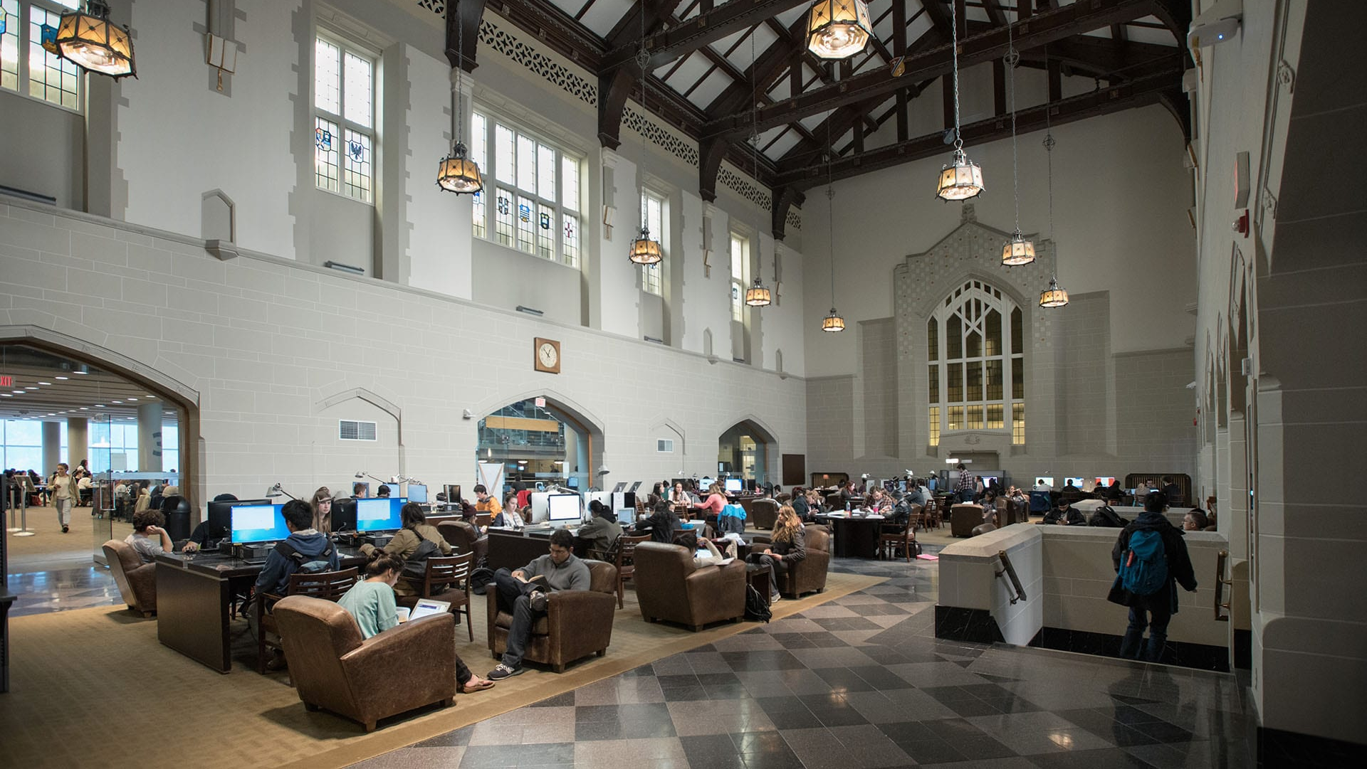
A wealth of knowledge: The Learning Centre’s access to library services is designed to support student learning, teaching, faculty research and to serve British Columbia’s communities.
University of British Columbia Library

Slide 35
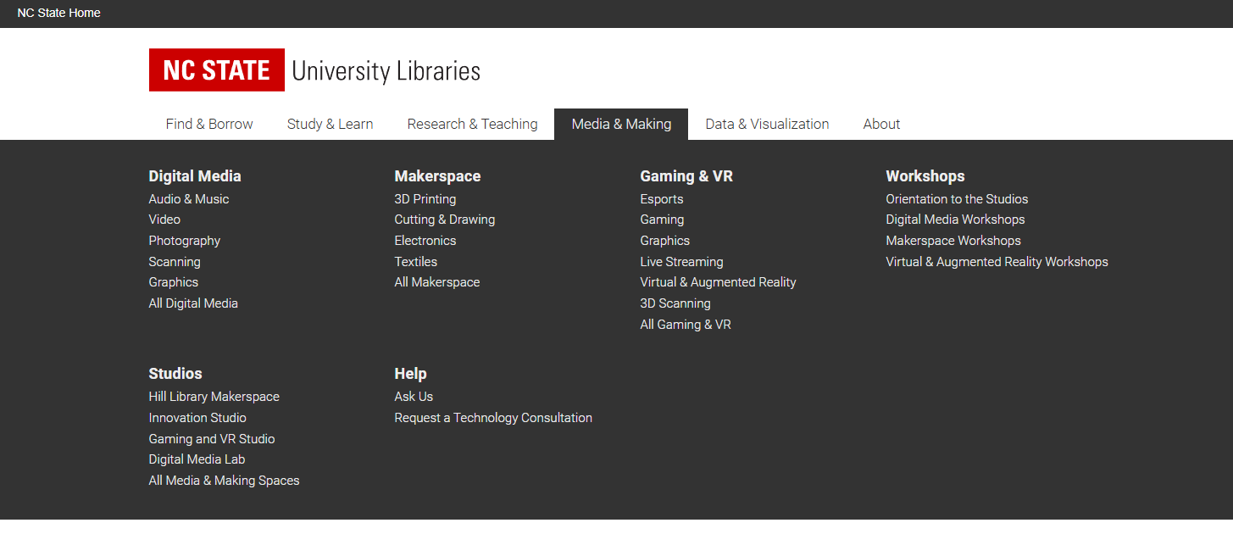
https://www.lib.ncsu.edu/

Slide 36
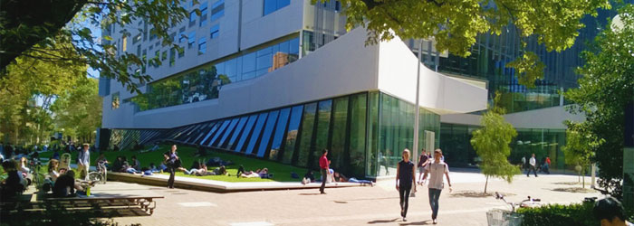
A central hub for student life. It offers a range of services and resources, including collaborative workspaces, individual study pods, a café, and a makerspace. The library also hosts events and exhibitions, fostering a sense of community and intellectual curiosity.

Slide 37
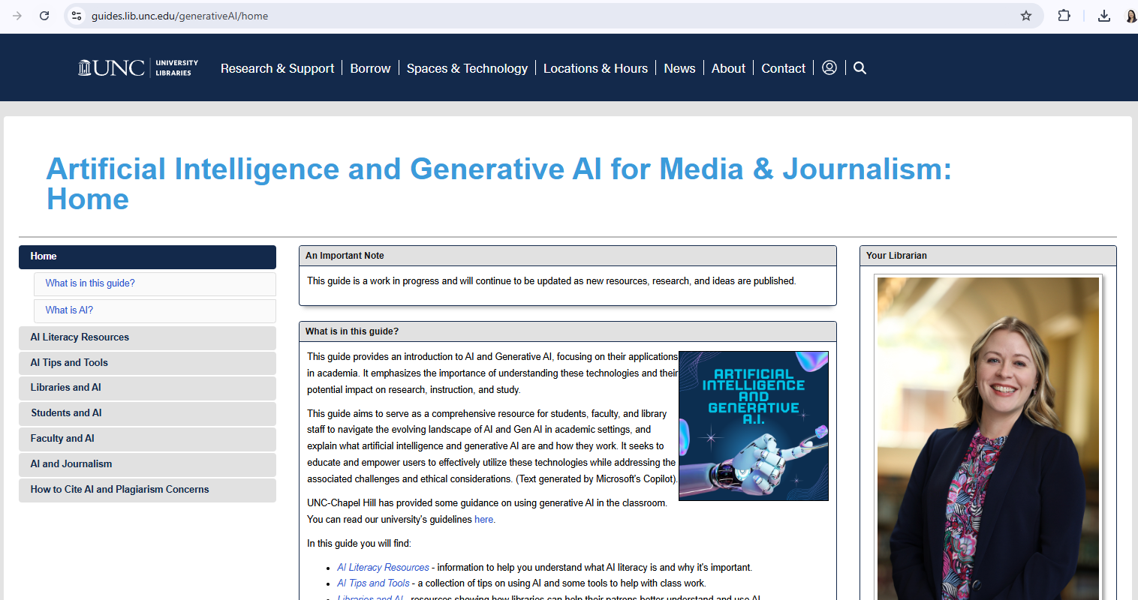
https://guides.lib.unc.edu/generativeAI/ai-tools

Slide 38


Slide 39
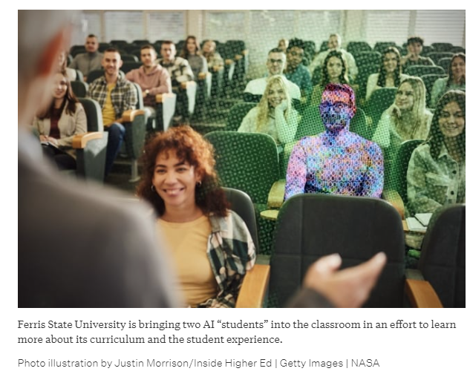
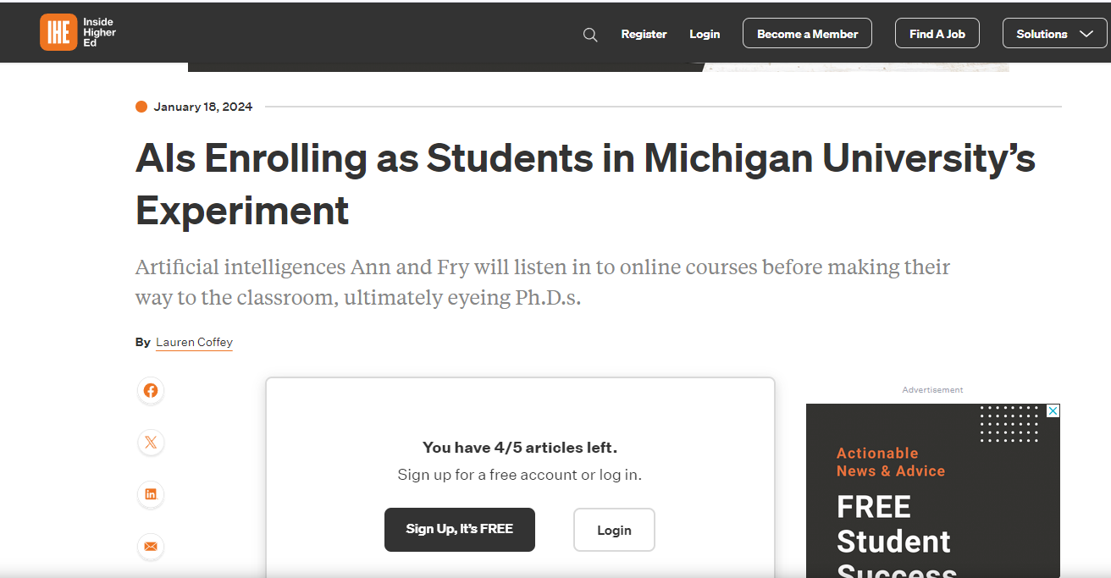
Source: https://www.insidehighered.com/news/tech-innovation/artificial-intelligence/2024/01/18/ais-enrolling-students-michigan-universitys

Slide 40
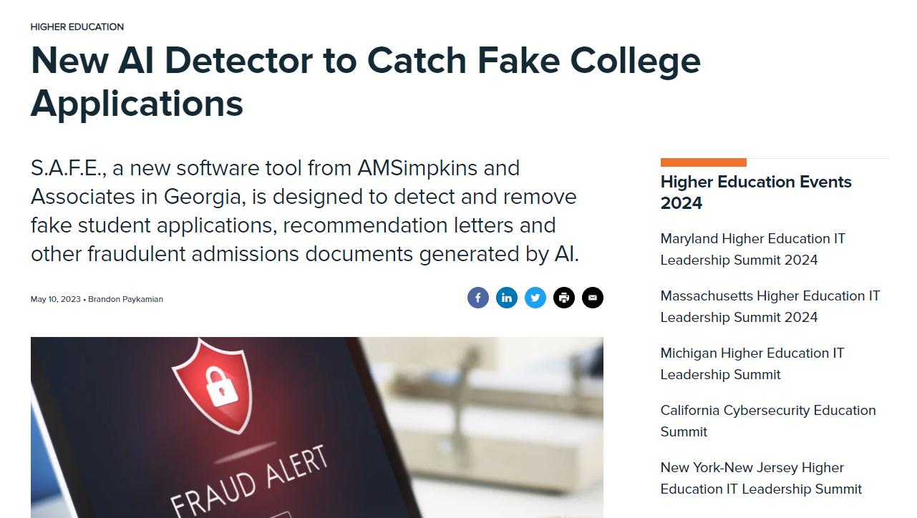


Slide 41
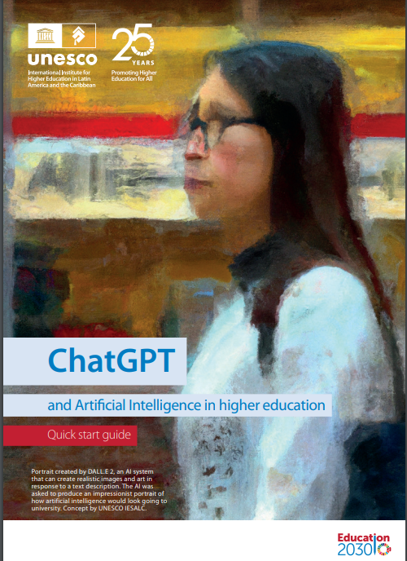
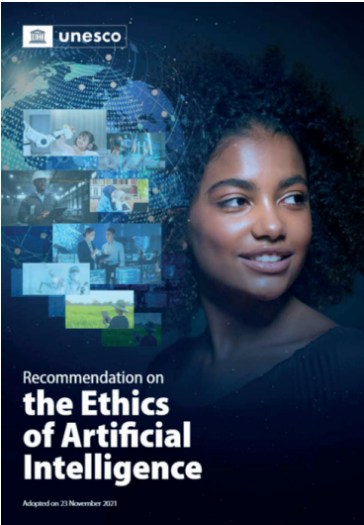
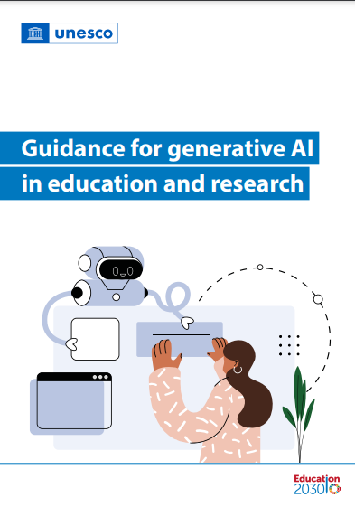
Source: https://www.iesalc.unesco.org/wp-content/uploads/2023/04/ChatGPT-and-Artificial-Intelligence-in-higher-education-Quick-Start-guide_EN_FINAL.pdf

Slide 42
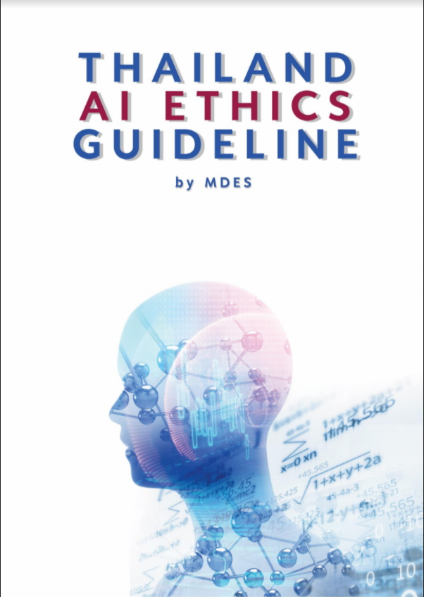
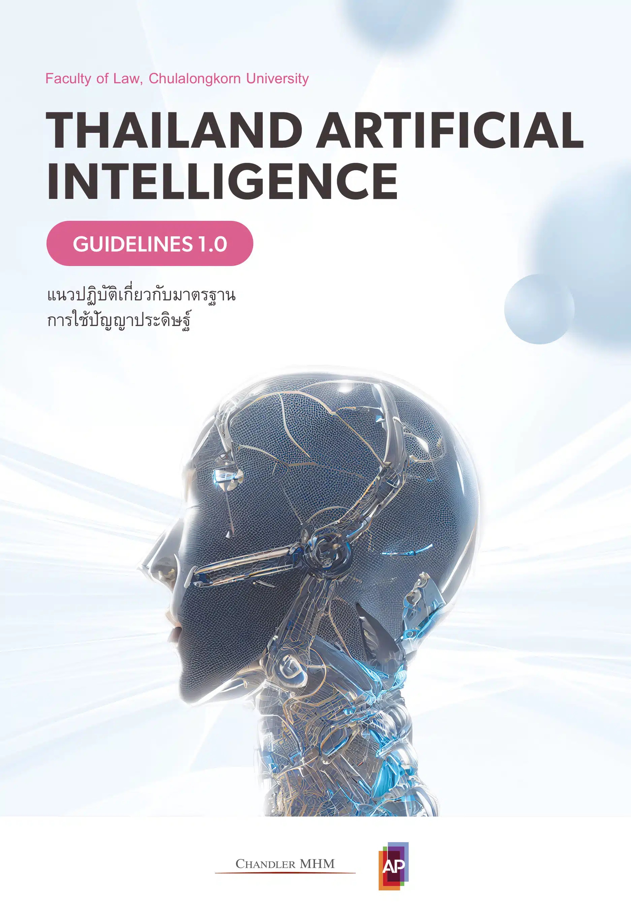
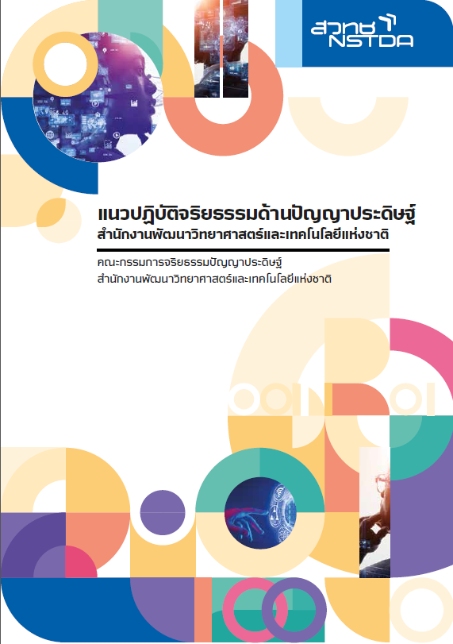
Source:
https://drive.google.com/drive/mobile/folders/1kB7dxS5nXibeX3UwP8ABQMlrO44xm41f
https://www.law.chula.ac.th/wp-content/uploads/2023/03/TAIG-20230222.pdf

Slide 43
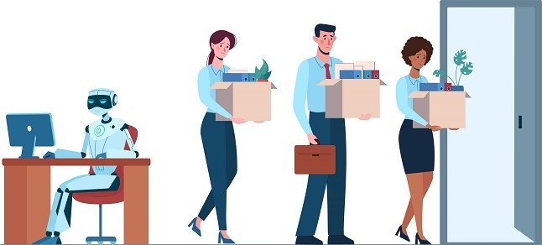
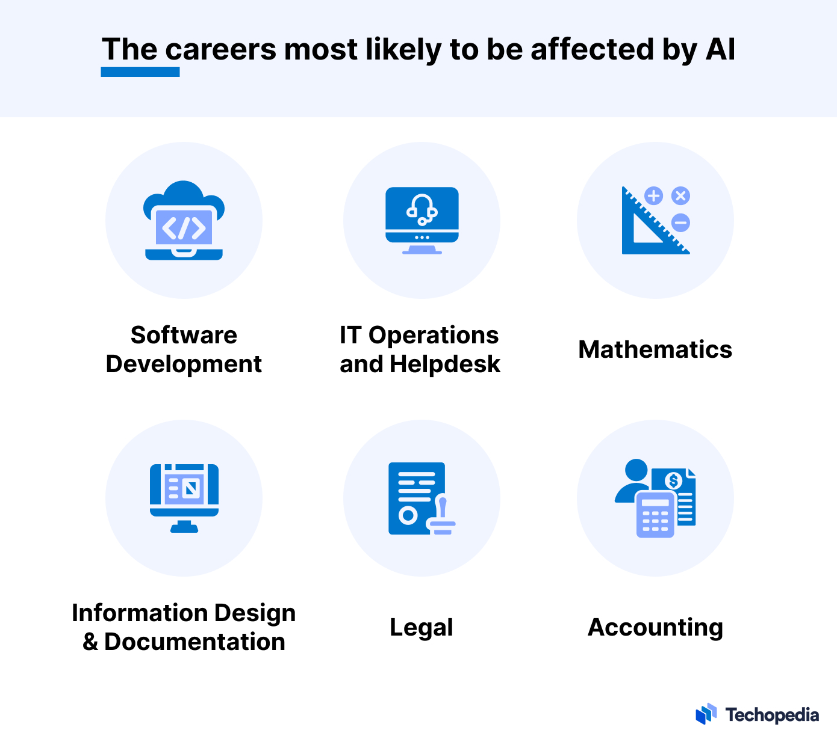
Job losses due to GenAI
Automation of Routine Tasks:
AI is automating repetitive jobs like data entry and manufacturing, leading to job reductions in these areas.
Impact on Skilled Jobs:
AI is increasingly capable of handling complex tasks, potentially displacing roles in fields like law, medicine, and finance.
New Job Opportunities:
While some jobs are lost, AI also creates new roles in areas like AI development and data science, but workers need reskilling to adapt.
Notes:
https://www.techopedia.com/ai-job-loss-predictions

Slide 44
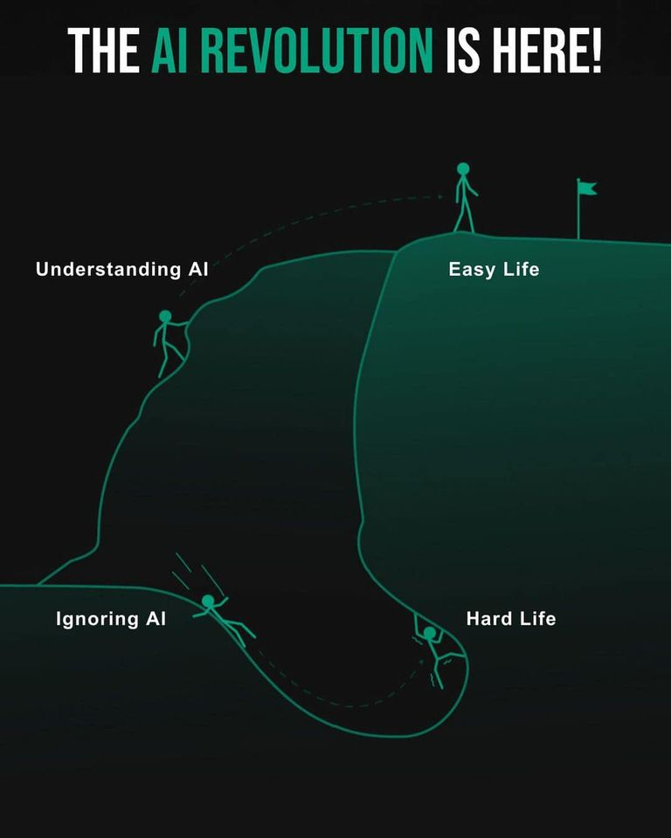
Source: https://twitter.com/PeterDiamandis/status/1677830993053470720

